Slide 1
Module 4: vCenter Server

Slide 2
Importance
vCenter Server helps you centrally manage multiple ESXi hosts and their virtual machines. If you do not properly deploy, configure, and manage vCenter Server Appliance, your environment might experience reduced administrative efficiency or ESXi host and virtual machine downtime.

Slide 3
Module Lessons
Centralized Management with vCenter Server
Deploying vCenter Server Appliance
vSphere Licensing
Managing the vCenter Server Inventory
vCenter Server Roles and Permissions
Backing Up and Restoring vCenter Server Appliance
Monitoring vCenter Server Appliance
vCenter Server High Availability

Slide 4
Virtual Beans: vCenter Server Requirements
Virtual Beans has the following requirements for vCenter Server (the management platform):
Use Active Directory for user and group authentication.
Restrict user access to vCenter Server:
System administrators: Administrative rights to the entire vSphere environment
Operators: Provision VMs and monitor, and troubleshoot vSphere problems
When the new data center comes online, manage both data centers from a centralized management console.
As a Virtual Beans administrator, you are responsible for installing and configuring vCenter Server, and setting up user access.

Slide 5

Lesson 1: Centralized Management with vCenter Server

Slide 6
Learner Objectives
After completing this lesson, you should be able to meet the following objectives:
Describe the vCenter Server architecture
Recognize how ESXi hosts communicate with vCenter Server
Identify vCenter Server services

Slide 7
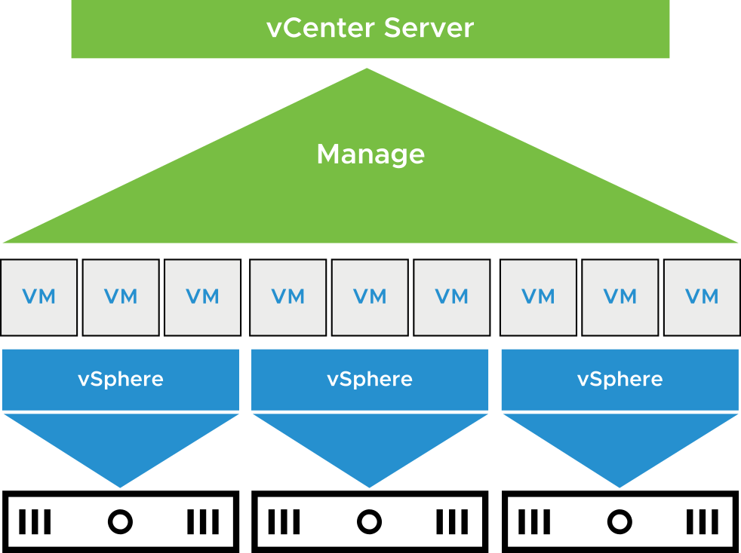
About the vCenter Server Management Platform
vCenter Server acts as a central administration point for ESXi hosts and virtual machines that are connected in a network:
Directs the actions of VMs and hosts
Runs on a Linux-based appliance
Notes:
With vCenter Server, you can pool and manage the resources of multiple hosts.
You can deploy vCenter Server Appliance on an ESXi host in your infrastructure. vCenter Server Appliance is a preconfigured Linux-based virtual machine that is optimized for running vCenter Server and the vCenter Server components.
vCenter Server Appliance provides advanced features, such as vSphere DRS, vSphere HA, vSphere Fault Tolerance, vSphere vMotion, and vSphere Storage vMotion.

Slide 8
About vCenter Server Appliance
vCenter Server Appliance is a prepackaged Linux-based VM that is optimized for running vCenter Server and associated services.
The vCenter Server Appliance package contains the following software:
Photon
PostgreSQL database
vCenter Server services
During deployment, you can select the vCenter Server Appliance size for your vSphere environment and the storage size for your database requirements.
Notes:
vCenter Server is a service that runs in vCenter Server Appliance. vCenter Server acts as a central administrator for ESXi hosts that are connected in a network.

Slide 9
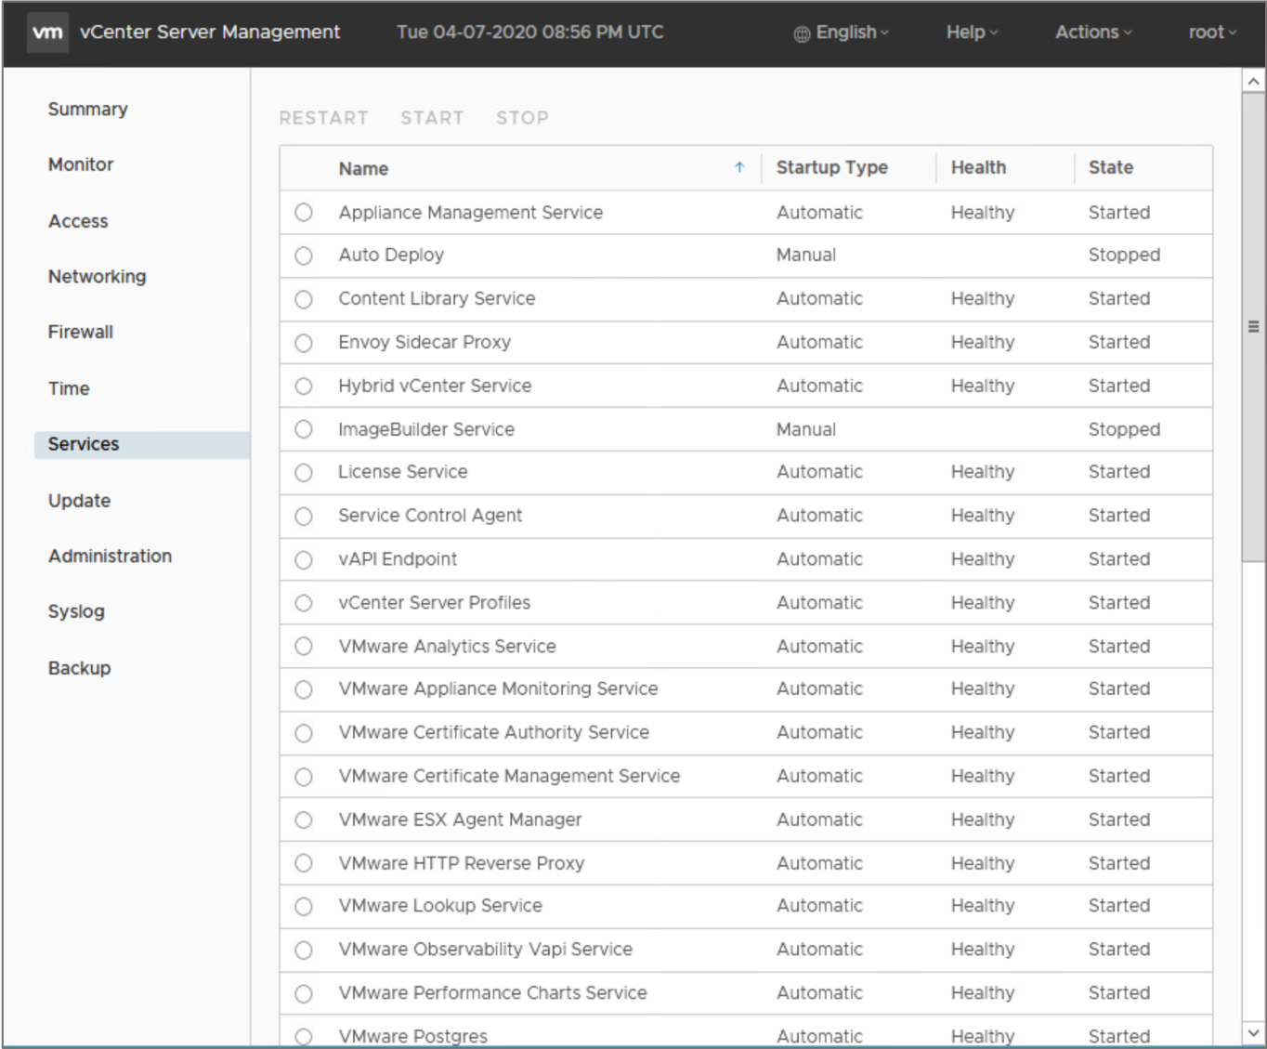
vCenter Server Services
vCenter Server services include:
vCenter Server
vSphere Client
vCenter Single Sign-On
License service
vCenter Lookup Service
VMware Certificate Authority
Content Library
vSphere ESXi Dump Collector
When you deploy vCenter Server Appliance, all these services are included.
Notes:
Although installation of vCenter Server services is not optional, administrators can choose whether to use their functionalities.

Slide 10
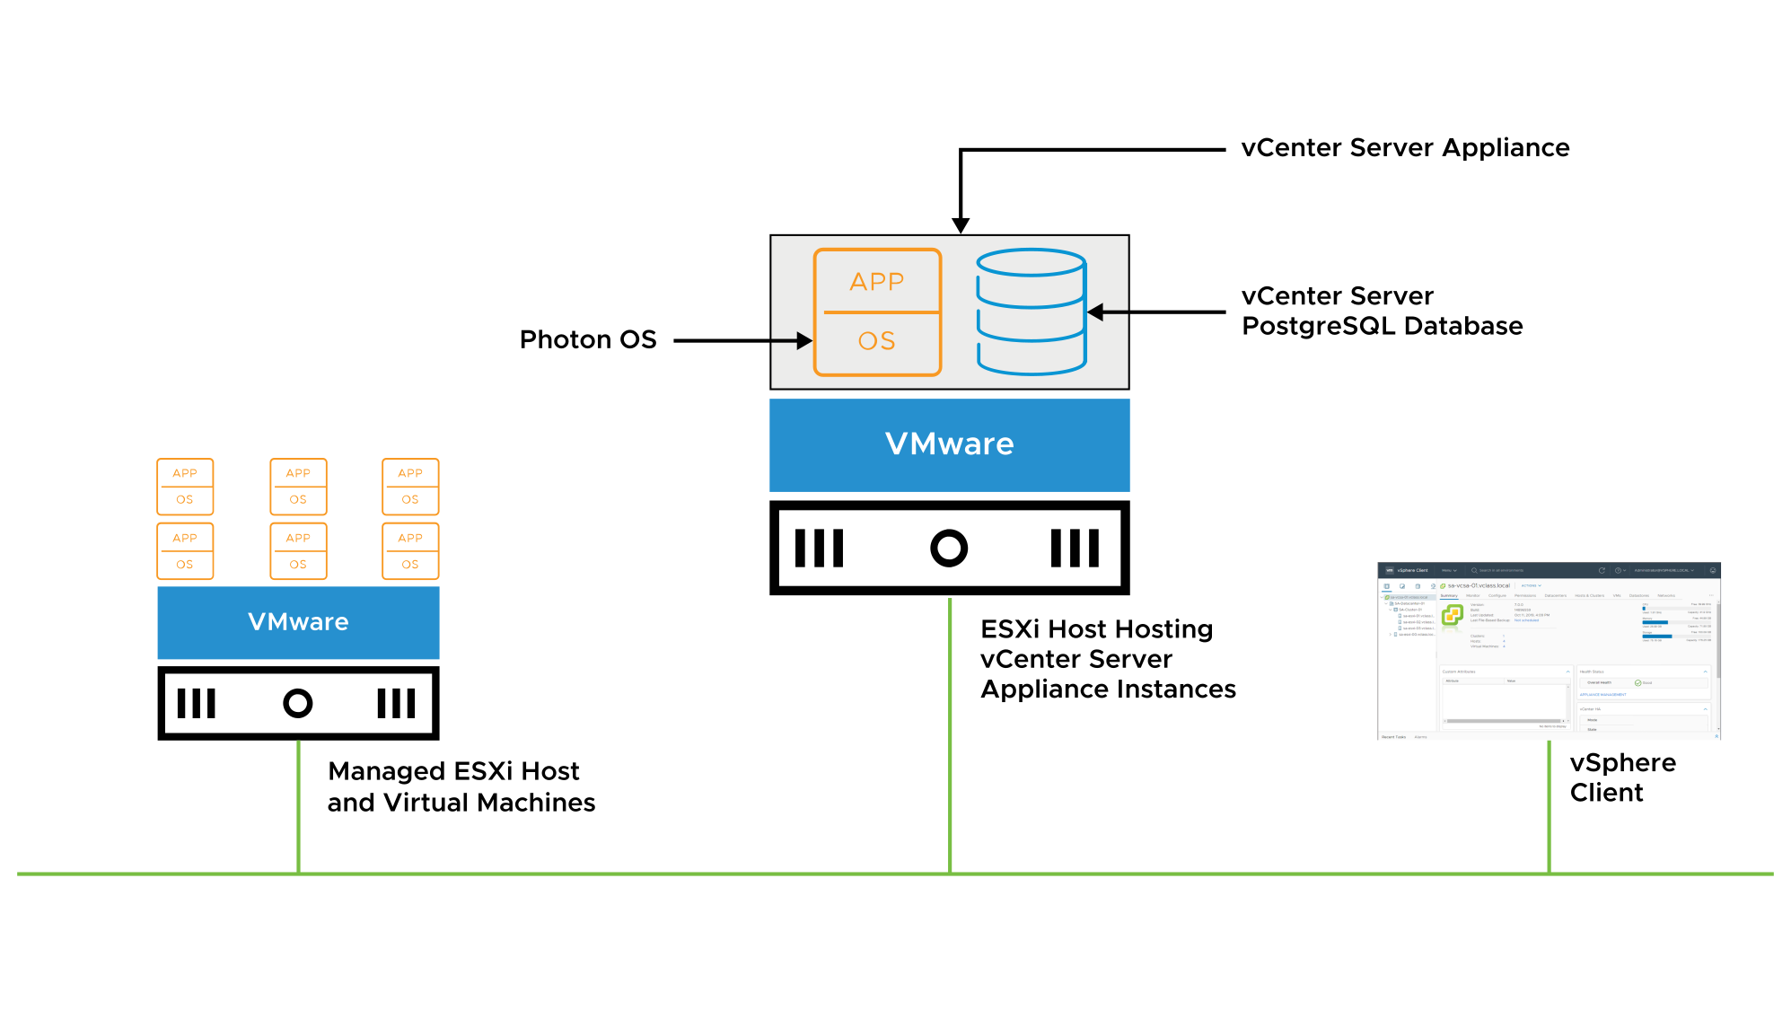
vCenter Server Architecture
vCenter Server is supported by the vSphere Client, the vCenter Server database, and managed hosts.
Notes:
The vCenter Server architecture relies on the following components:
vSphere Client: You use this client to connect to vCenter Server so that you can manage your ESXi hosts centrally. When an ESXi host is managed by vCenter Server, you should always use vCenter Server and the vSphere Client to manage that host.
vCenter Server database: The vCenter Server database is the most important component. The database stores inventory items, security roles, resource pools, performance data, and other critical information for vCenter Server.
Managed hosts: You can use vCenter Server to manage ESXi hosts and the VMs that run on them.

Slide 11
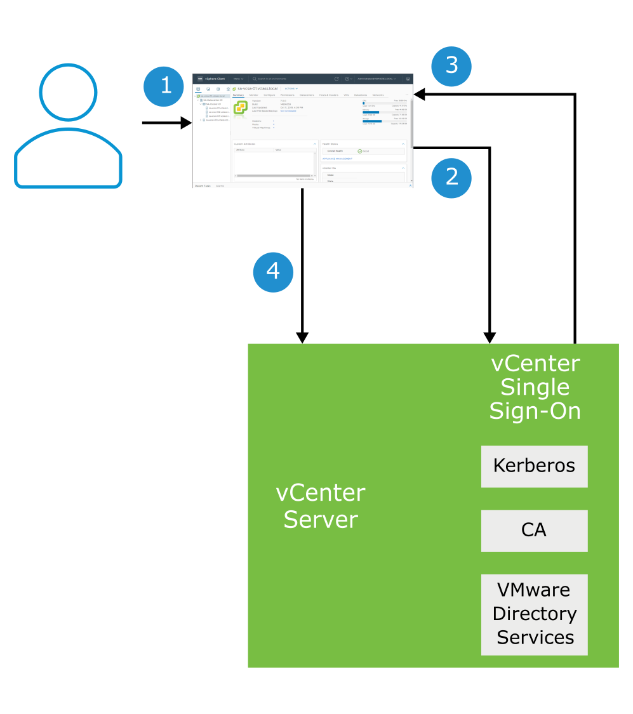
About vCenter Single Sign-On
vCenter Single Sign-On provides authentication across multiple vSphere components through a secure token mechanism:
User logs in to the vSphere Client.
vCenter Single Sign-On authenticates credentials against a directory service (for example, Active Directory).
A SAML token is sent back to the user's browser.
The SAML token is sent to vCenter Server, and the user is granted access.

Slide 12
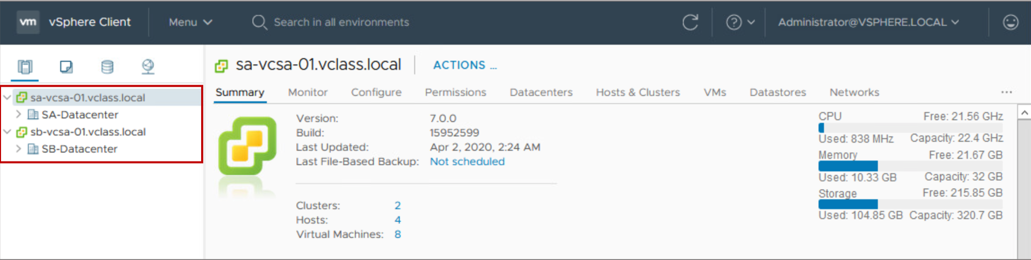
About Enhanced Linked Mode
With Enhanced Linked Mode, you can log in to a single instance of vCenter Server and manage the inventories of all the vCenter Server systems in the group:
Up to 15 vCenter Server instances can be linked in one vCenter Single Sign-On domain.
An Enhanced Linked Mode group can be created only during the deployment of vCenter Server Appliance.
Notes:
You cannot create an Enhanced Linked Mode group after you deploy vCenter Server Appliance.
Enhanced Linked Mode provides the following features:
You can log in to all linked vCenter Server instances simultaneously with a single user name and password.
You can view and search the inventories of all linked vCenter Server instances in the vSphere Client.
Roles, permission, licenses, tags, and policies are replicated across linked vCenter Server instances.
To join vCenter Server instances in Enhanced Linked Mode, connect the vCenter Server instances to the same vCenter Single Sign-On domain.
Enhanced Linked Mode requires the vCenter Server Standard licensing level. This mode is not supported with vCenter Server Foundation or vCenter Server for Essentials.

Slide 13
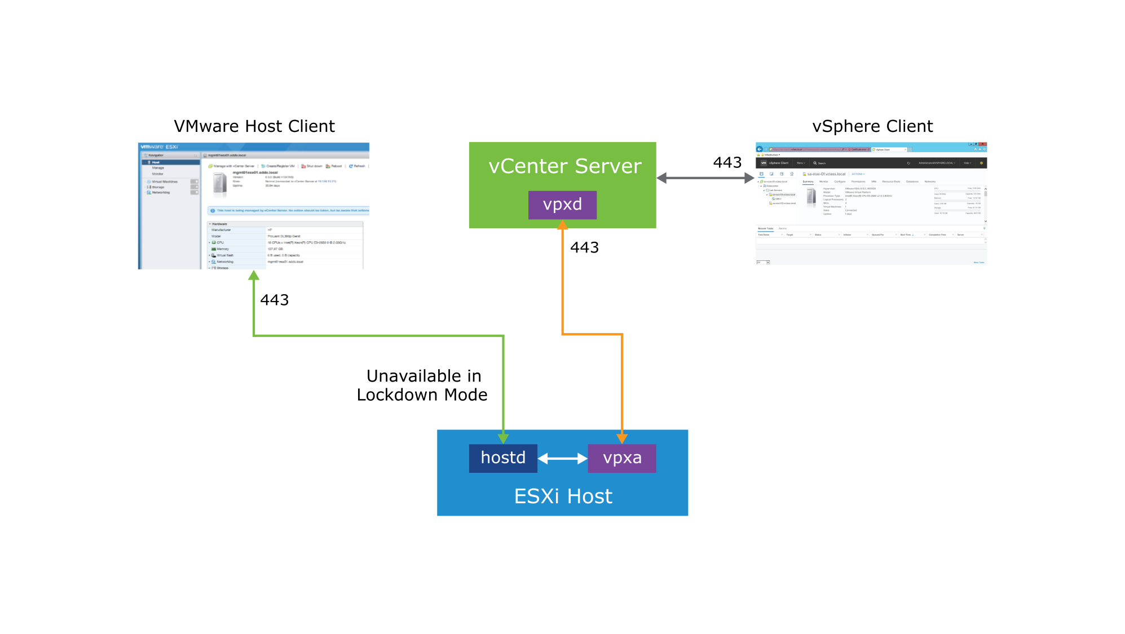
ESXi and vCenter Server Communication
The vSphere Client communicates directly with vCenter Server. To communicate directly with an ESXi host, you use VMware Host Client.
Notes:
vCenter Server provides direct access to the ESXi host through a vCenter Server agent called virtual provisioning X agent (vpxa). The vpxa process is automatically installed on the host and started when the host is added to the vCenter Server inventory. The vCenter Server service (vpxd) communicates with the ESXi host daemon (hostd) through the vCenter Server agent (vpxa).
Clients that communicate directly with the host, and bypass vCenter Server, converse with hostd. The hostd process runs directly on the ESXi host and manages most of the operations on the ESXi host. The hostd process is aware of all VMs that are registered on the ESXi host, the storage volumes visible to the ESXi host, and the status of all VMs. Most commands or operations come from vCenter Server through vpxa. Examples include creating, migrating, and powering on virtual machines. Acting as an intermediary between the vpxd process, which runs on vCenter Server, and the hostd process, vpxa relays the tasks to perform on the host. When you are logged in to the vCenter Server system through the vSphere Client, vCenter Server passes commands to the ESXi host through the vpxa. The vCenter Server database is also updated. If you use VMware Host Client to communicate directly with an ESXi host, communications go directly to the hostd process and the vCenter Server database is not updated.

Slide 14
vCenter Server Appliance Scalability
Metric | vCenter Server Appliance 7.0
Hosts per vCenter Server instance | 2,500
Powered-on VMs per vCenter Server instance | 40,000
Registered VMs per vCenter Server instance | 45,000
Hosts per cluster | 64
VMs per cluster | 8,000

Slide 15
Review of Learner Objectives
After completing this lesson, you should be able to meet the following objectives:
Describe the vCenter Server architecture
Recognize how ESXi hosts communicate with vCenter Server
Identify vCenter Server services

Slide 16
Lesson 2: Deploying vCenter Server Appliance

Slide 17
Learner Objectives
After completing this lesson, you should be able to meet the following objectives:
Deploy vCenter Server Appliance into an infrastructure
Configure vCenter Server settings

Slide 18
Preparing for vCenter Server Appliance Deployment
Before deploying vCenter Server Appliance, you must complete several tasks:
Verify that all vCenter Server Appliance system requirements are met.
Get the fully qualified domain name (FQDN) or the static IP of the host machine on which you install vCenter Server Appliance.
Ensure that clocks on all VMs in the vSphere network are synchronized.
Notes:
For more information, see VMware ESXi Installation and Setup at https://docs.vmware.com/en/VMware-vSphere/7.0/com.vmware.esxi.install.doc/GUID-B2F01BF5-078A-4C7E-B505-5DFFED0B8C38.html.

Slide 19
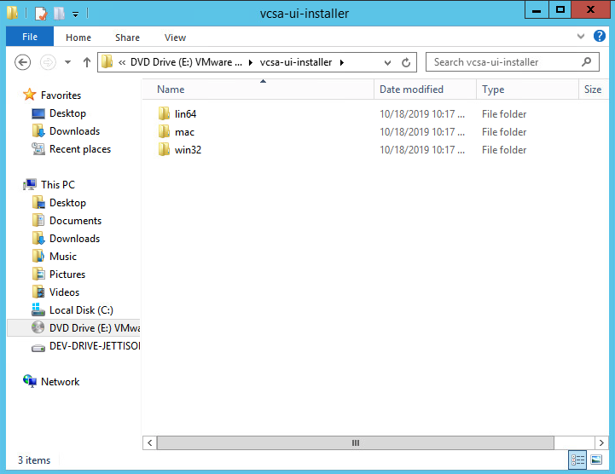
vCenter Server Appliance Native GUI Installer
The GUI installer has several features:
With the GUI installer, you can perform an interactive deployment of vCenter Server Appliance.
The GUI installer is a native application for Windows, Linux, and macOS.
The installer has no dependency on browsers or plug-ins.
It performs validations and prechecks during the deployment.
Notes:
The GUI installer performs validations and prechecks during the deployment phase to ensure that no mistakes are made and that a compatible environment is created.

Slide 20
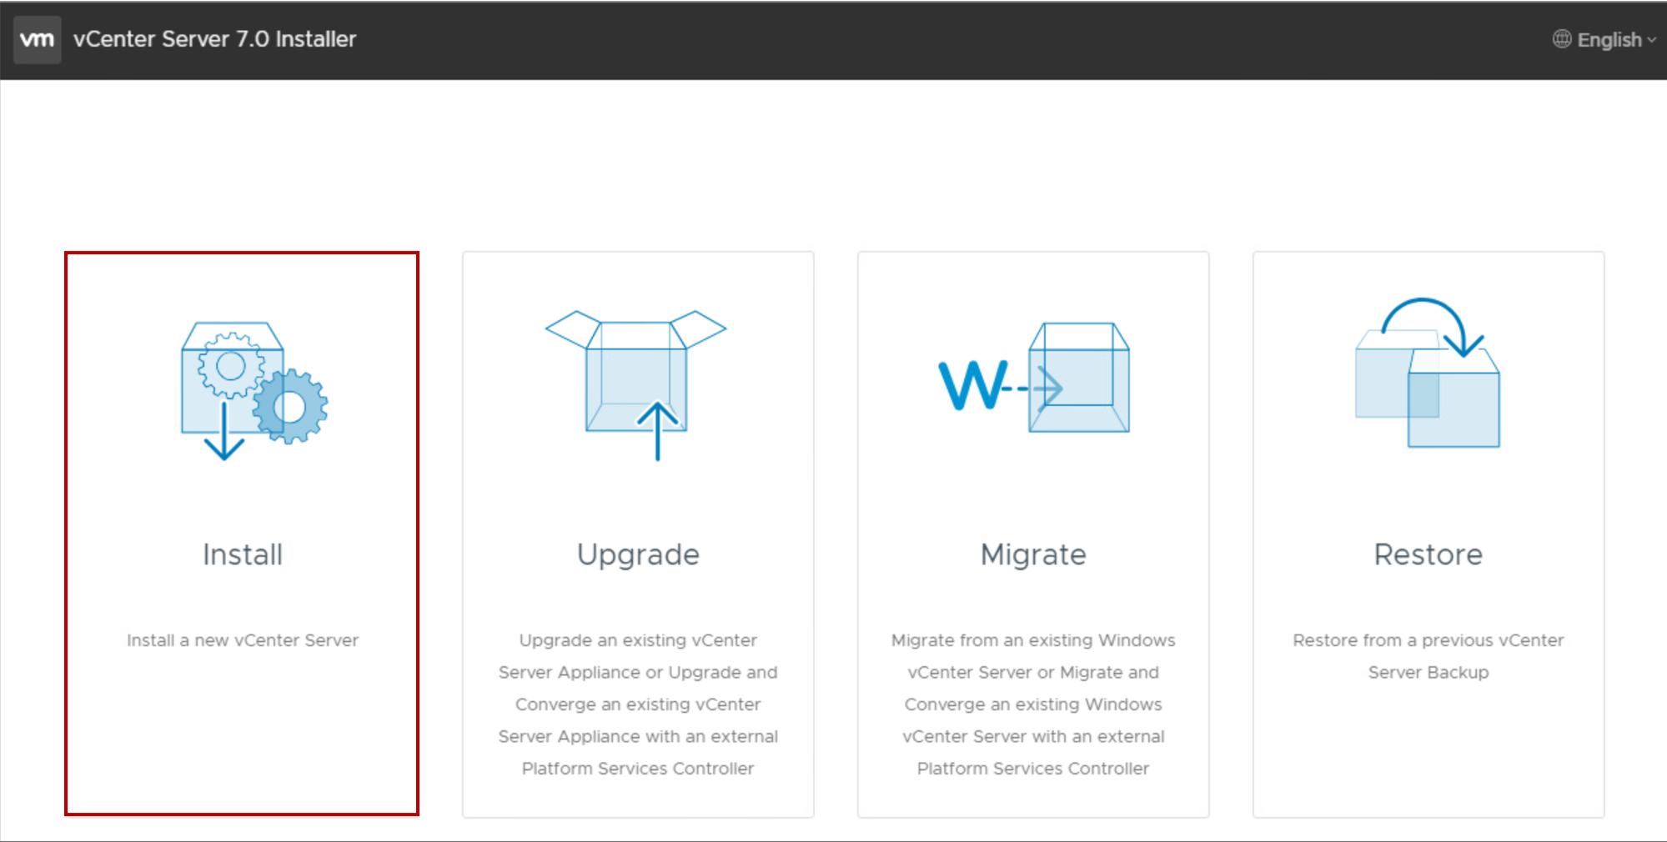
vCenter Server Appliance Installation
The vCenter Server Appliance installation is a two-stage process:
Stage 1: Deployment of OVF
Stage 2: Configuration
The deployment can be fully automated by using JSON templates with the CLI installer on Windows, Linux, or macOS.
Notes:
The Install option installs a new vCenter Server Appliance.
The Upgrade option upgrades an existing vCenter Server Appliance instance, or upgrades and converges an existing vCenter Server Appliance instance with external Platform Services Controller.
The Migrate option migrates from an existing Windows vCenter Server instance, or migrates and converges an existing Windows vCenter Server instance with external Platform Services Controller.
The Restore option restores from a previous vCenter Server Appliance backup.

Slide 21
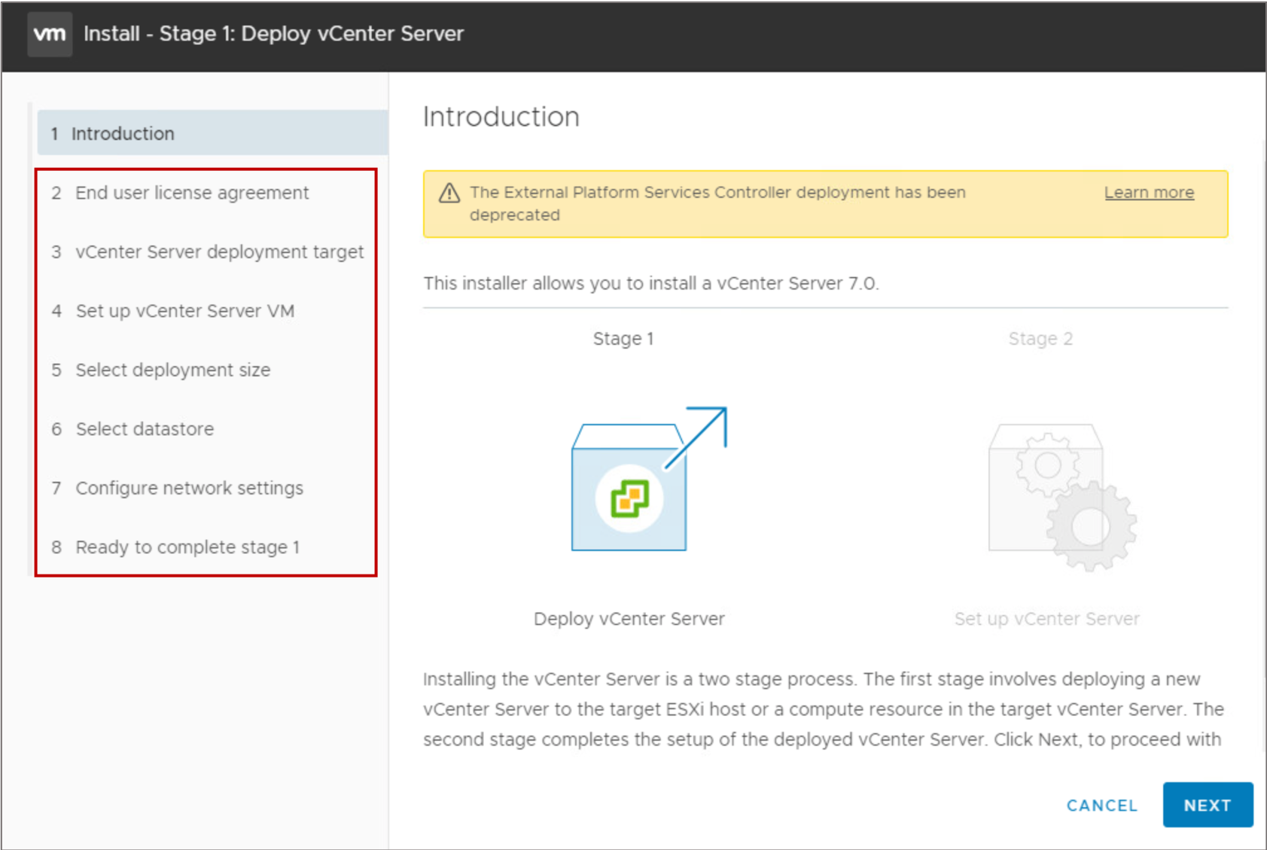
vCenter Server Appliance Installation: Stage 1
Stage 1 begins with the UI phase:
Accept the EULA.
Connect to the target ESXi host or vCenter Server system.
Define the vCenter Server Appliance name and root password.
Select compute size, storage size, and datastore location (thin disk).
Define networking settings.
Stage 1 continues with the deployment phase:
OVF is deployed to the ESXi host.
Disks and networking are configured.

Slide 22
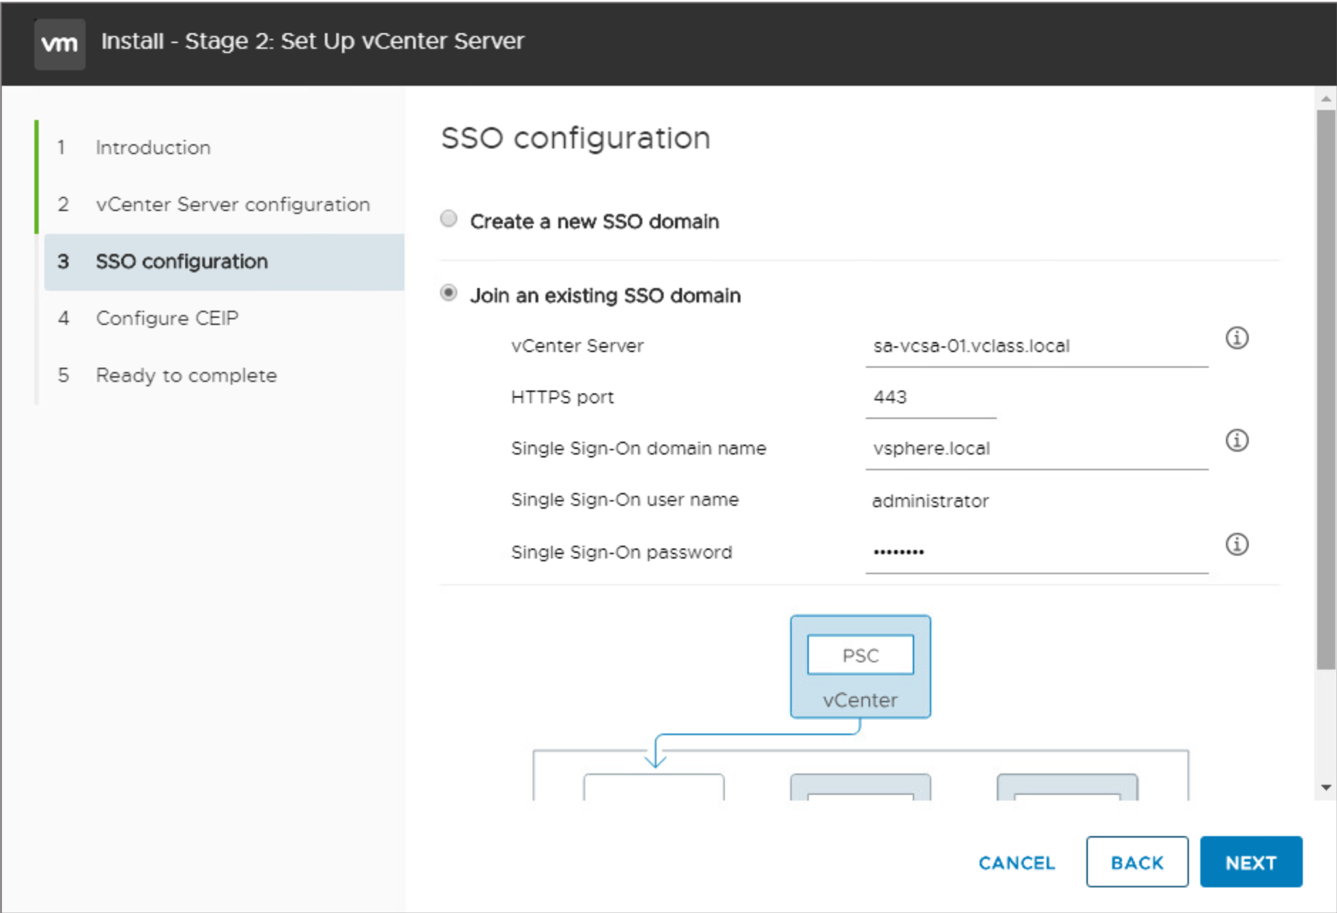
vCenter Server Appliance Installation: Stage 2
Stage 2 is the configuration phase:
Configure time synchronization mode and SSH access.
Create a vCenter Single Sign-On domain or join an existing SSO domain.
Join the Customer Experience Improvement Program (CEIP).
Notes:
In stage 2, you configure whether to use the ESXi host or NTP servers as the time synchronization source. You can also enable SSH access. SSH access is disabled by default.

Slide 23
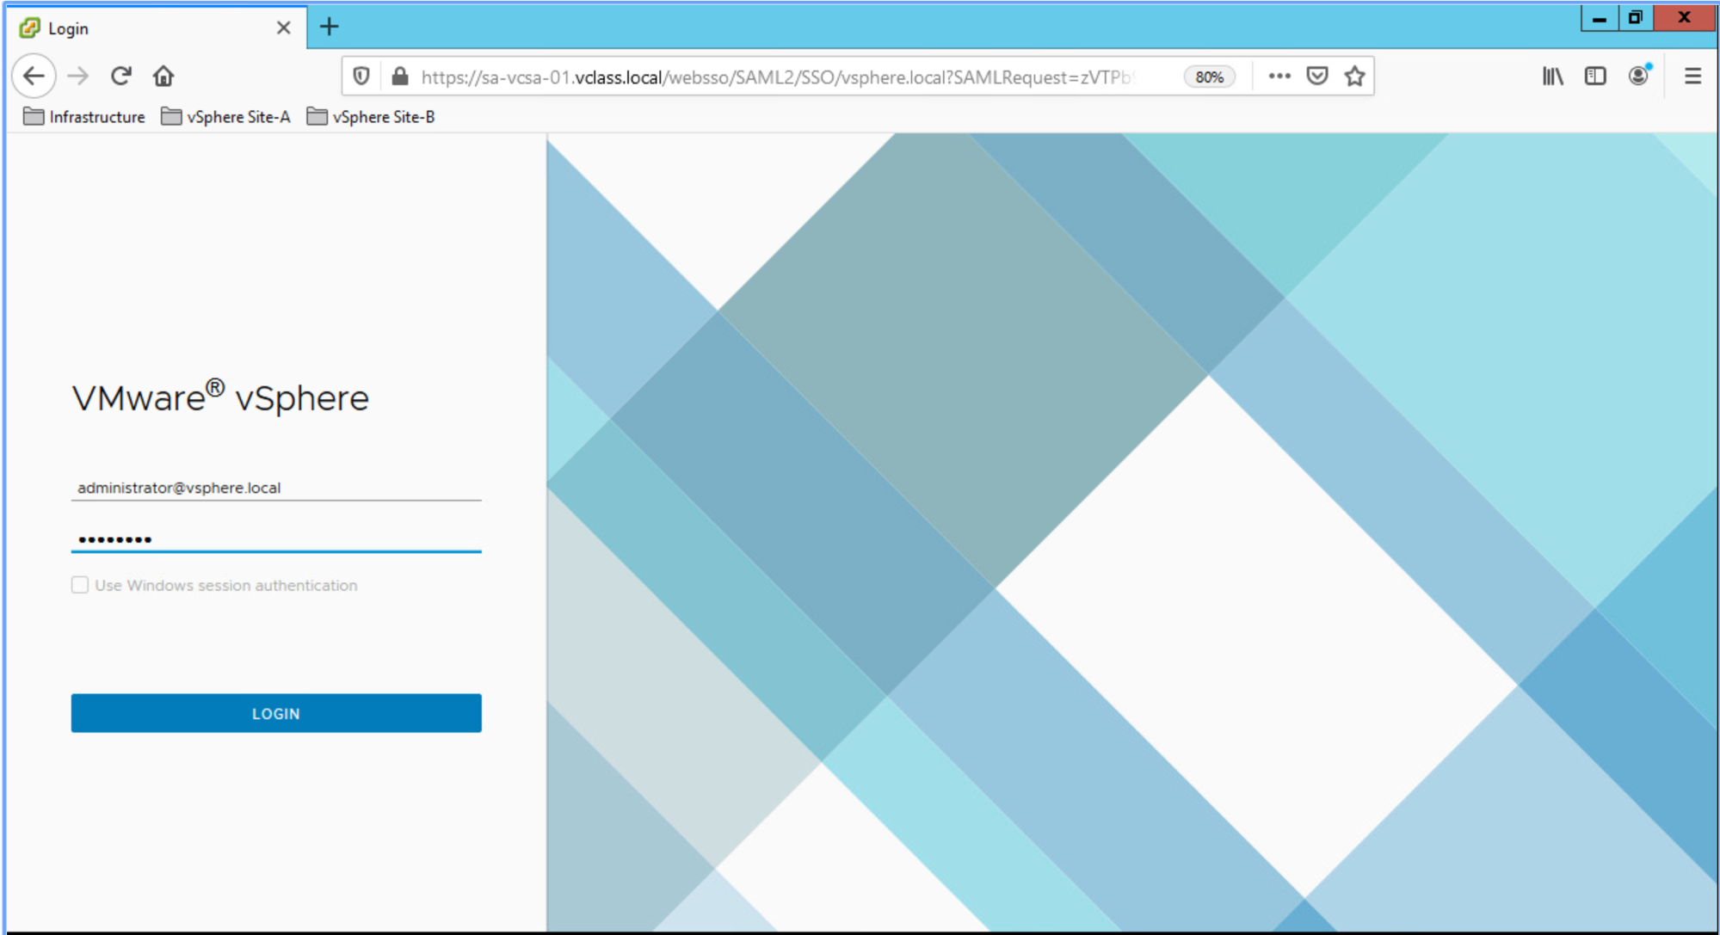
Getting Started with vCenter Server
After you deploy vCenter Server Appliance, use the vSphere Client to log in and manage your vCenter Server inventory: https://vCenter_Server_FQDN_or_IP_address/ui.

Slide 24
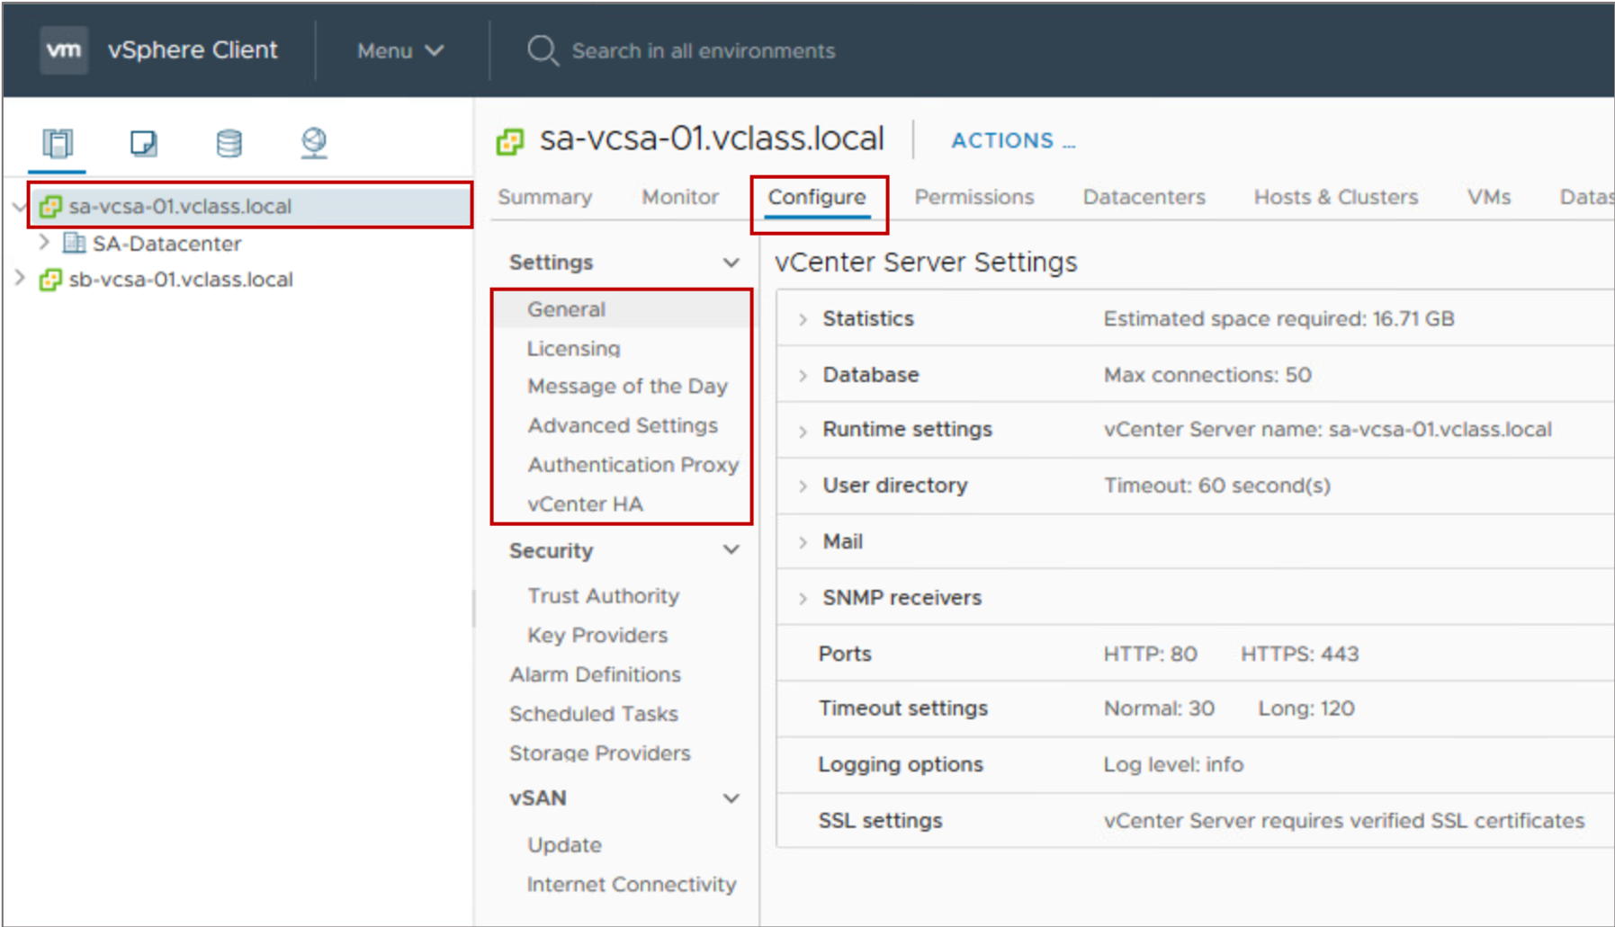
Configuring vCenter Server Using the vSphere Client
Using the vSphere Client, you can configure vCenter Server, including settings such as licensing, statistics collection, and logging.
Notes:
To access the vCenter Server system settings by using the vSphere Client, select the vCenter Server system in the navigation pane, click the Configure tab, and expand Settings.

Slide 25
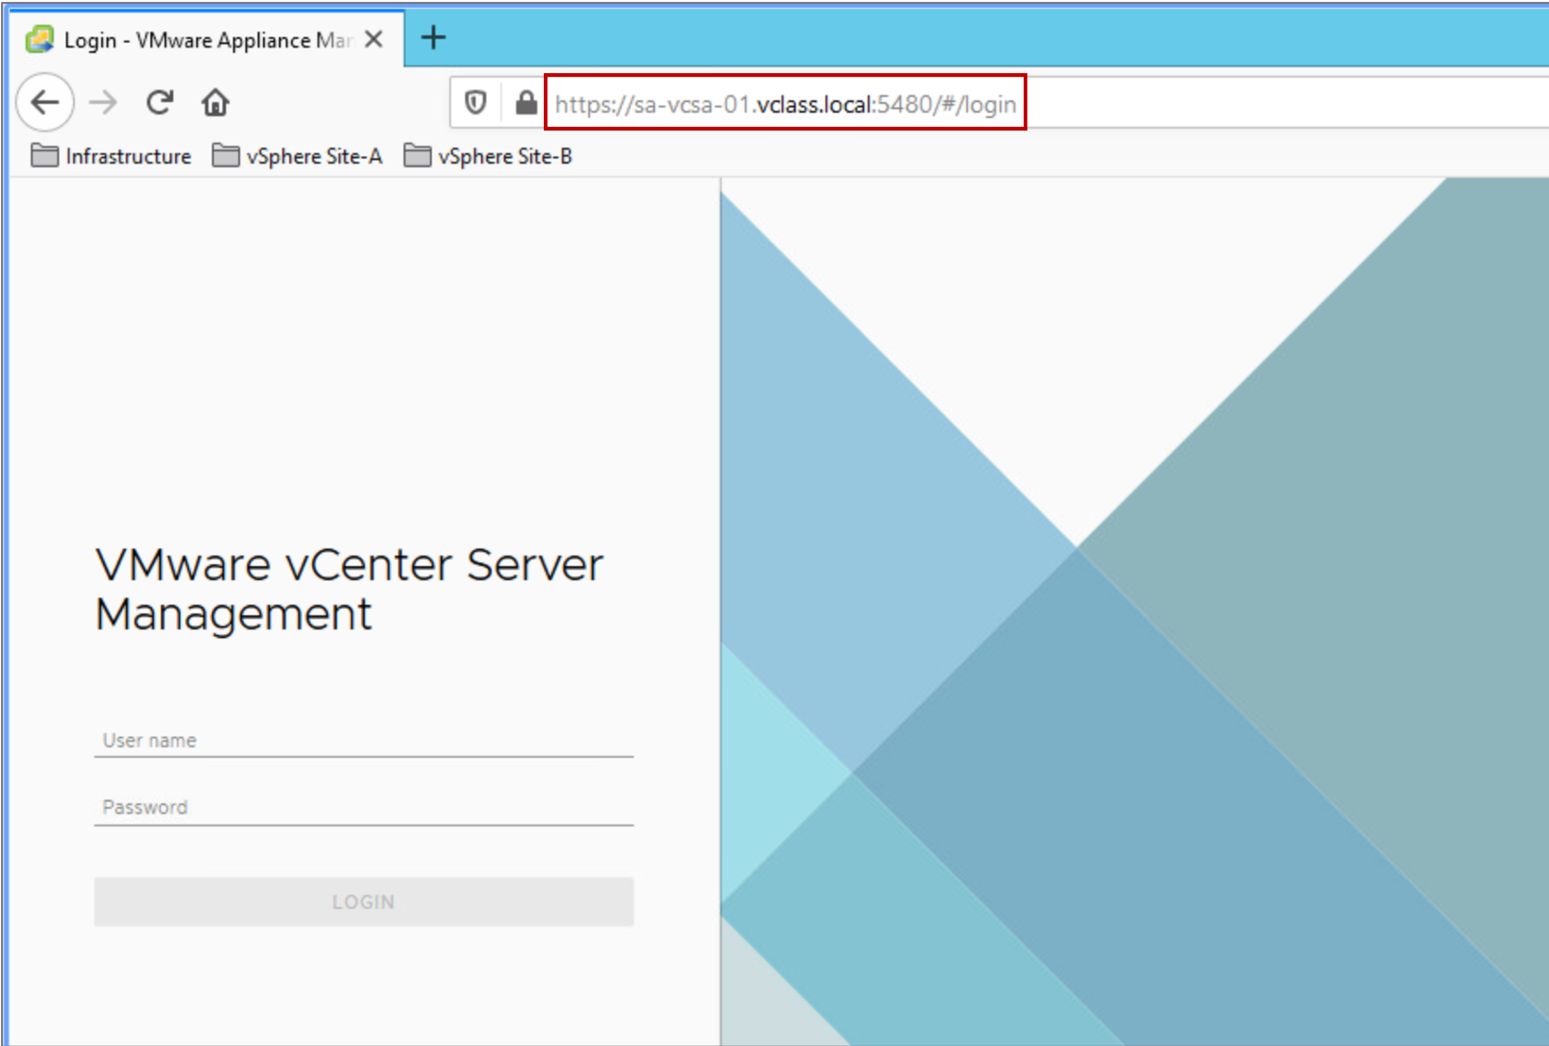
vCenter Server Appliance Management Interface
Using the vCenter Server Appliance Management Interface (VAMI), you can configure and monitor your vCenter Server Appliance instance.
Tasks include:
Monitoring resource use by the appliance
Backing up the appliance
Monitoring vCenter Server services
Adding additional network adapters
Notes:
The vCenter Server Appliance Management Interface is an HTML client designed to configure and monitor vCenter Server Appliance.
The vCenter Server Appliance Management Interface connects directly to port 5480. Use the URL https://FQDN_or_IP_address:5480.

Slide 26
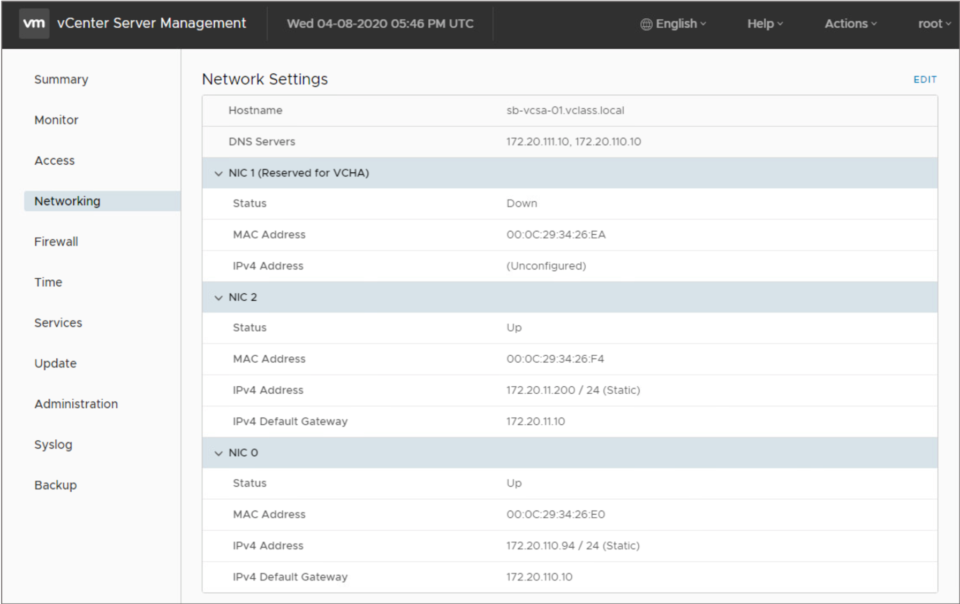
vCenter Server Appliance Multihoming
With vCenter Server Appliance 7.0 multihoming, you can configure multiple NICs to manage network traffic.
For example, vCenter Server High Availability requires a second NIC for its private network.
Notes:
A maximum of four NICs are supported for multihoming. All four multihoming-supported NIC configurations are preserved during upgrade, backup, and restore processes.

Slide 27
Demonstration: Deploying vCenter Server Appliance
Your instructor will run a demonstration.

Slide 28
Review of Learner Objectives
After completing this lesson, you should be able to meet the following objectives:
Deploy vCenter Server Appliance into an infrastructure
Configure vCenter Server settings

Slide 29
Lesson 3: vSphere Licensing

Slide 30
Learner Objectives
After completing this lesson, you should be able to meet the following objectives:
View licensed features for vCenter Server or an ESXi host
Add license keys to vCenter Server

Slide 31
vSphere Licensing Overview
Licensing vSphere components is a two-step process:
Add a license to the vCenter License Service.
Assign the license to the ESXi hosts, vCenter Server Appliance instances, and other vSphere components.

Slide 32
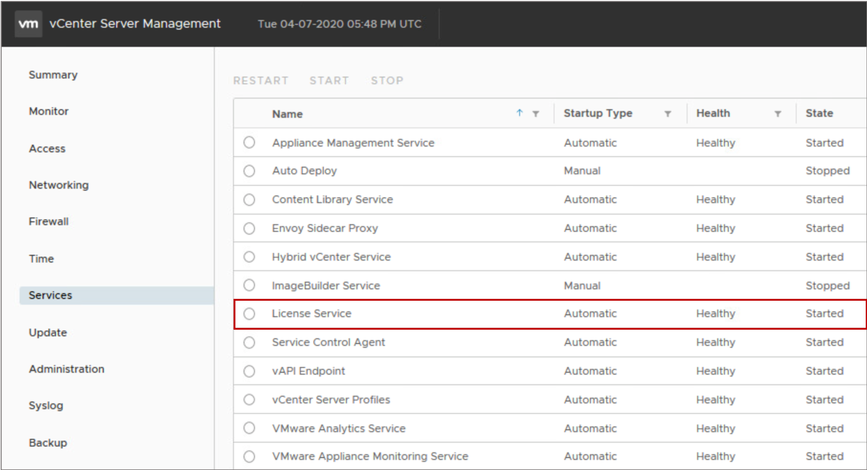
vSphere License Service
The License Service runs on vCenter Server Appliance.
The License Service performs the following functions:
Provides centralized license management
Provides an inventory of vSphere licenses
Manages the license assignments for products that integrate with vSphere, such as Site Recovery Manager.
Notes:
The License Service manages the license assignments for ESXi hosts, vCenter Server systems, and clusters with vSAN enabled.
You can monitor the health and status of the License Service by using the vCenter Appliance Management Interface.

Slide 33
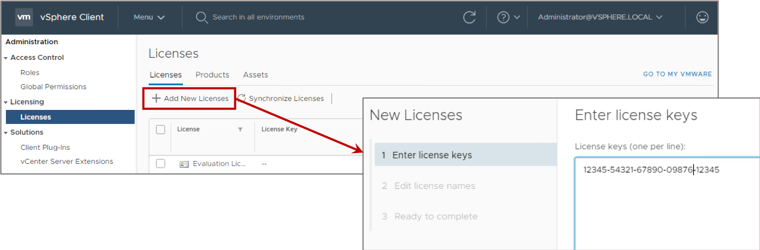
Adding License Keys to vCenter Server
You must assign a license to vCenter Server before its 60-day evaluation period expires.
Select Menu > Administration > Licenses to open the Licenses pane.
Notes:
In the vSphere environment, license reporting and management are centralized. All product and feature licenses are encapsulated in 25-character license keys that you can manage and monitor from vCenter Server.
You can view license information by product, license key, or asset:
Product: A license to use a vSphere software component or feature, for example, evaluation mode or vSphere Enterprise Plus.
License key: The serial number that corresponds to a product.
Asset: A machine on which a product is installed. For an asset to run certain software legally, the asset must be licensed.

Slide 34
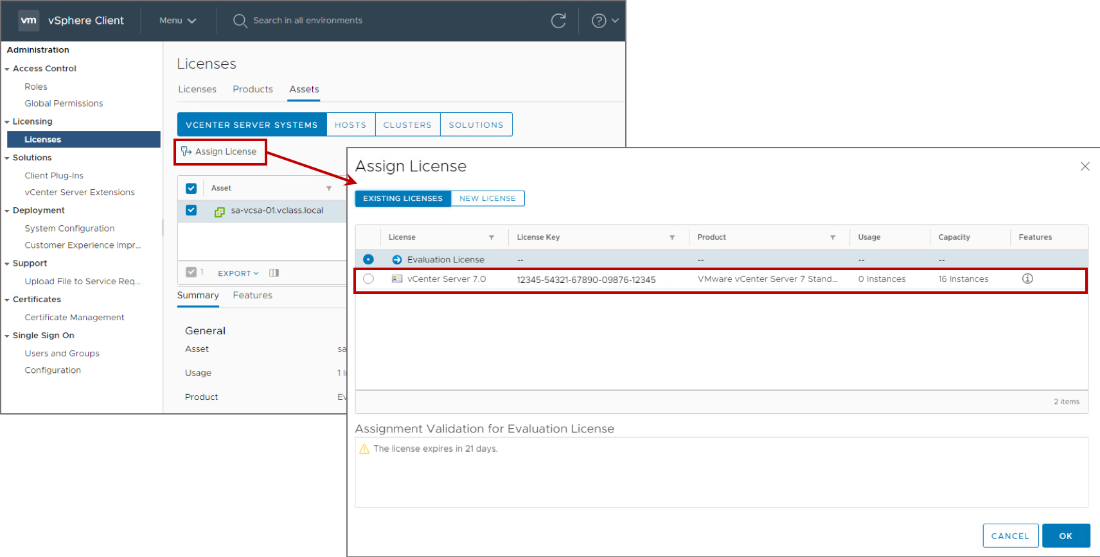
Assigning the License to the vSphere Component
You can assign a license to an asset, such as vCenter Server.

Slide 35
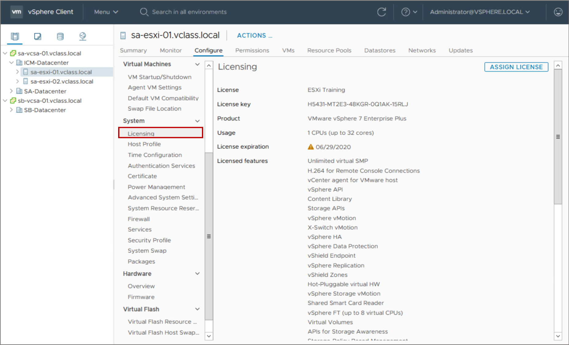
Viewing Licensed Features
You assign valid license keys to your ESXi hosts and vCenter Server instance using the Licensing pane. This pane shows the type of license and available features.
Notes:
Before purchasing and activating licenses for ESXi and vCenter Server, you can install the software and run it in evaluation mode. Evaluation mode is intended for demonstrating the software or evaluating its features. During the evaluation period, the software is operational.
The evaluation period is 60 days from the time of installation. During this period, the software notifies you of the time remaining until expiration. The 60-day evaluation period cannot be paused or restarted. After the evaluation period expires, you can no longer perform some operations in vCenter Server and ESXi. For example, you cannot power on or reset your virtual machines. In addition, all hosts are disconnected from the vCenter Server system. To continue to have full use of ESXi and vCenter Server operations, you must acquire license keys.

Slide 36
Lab 6: Adding vSphere Licenses
Use the vSphere Client to add vSphere licenses to vCenter Server and assign a license to vCenter Server:
Add vSphere Licenses to vCenter Server
Assign a License to the vCenter Server Instance

Slide 37
Review of Learner Objectives
After completing this lesson, you should be able to meet the following objectives:
View licensed features for vCenter Server or an ESXi host
Add license keys to vCenter Server

Slide 38
Lesson 4: Managing the vCenter Server Inventory

Slide 39
Learner Objectives
After completing this lesson, you should be able to meet the following objectives:
Use the vSphere Client to manage the vCenter Server inventory
Create and organize vCenter Server inventory objects
Add data center and organizational objects to vCenter Server
Add hosts to vCenter Server
Recognize how to create custom inventory tags for inventory objects

Slide 40
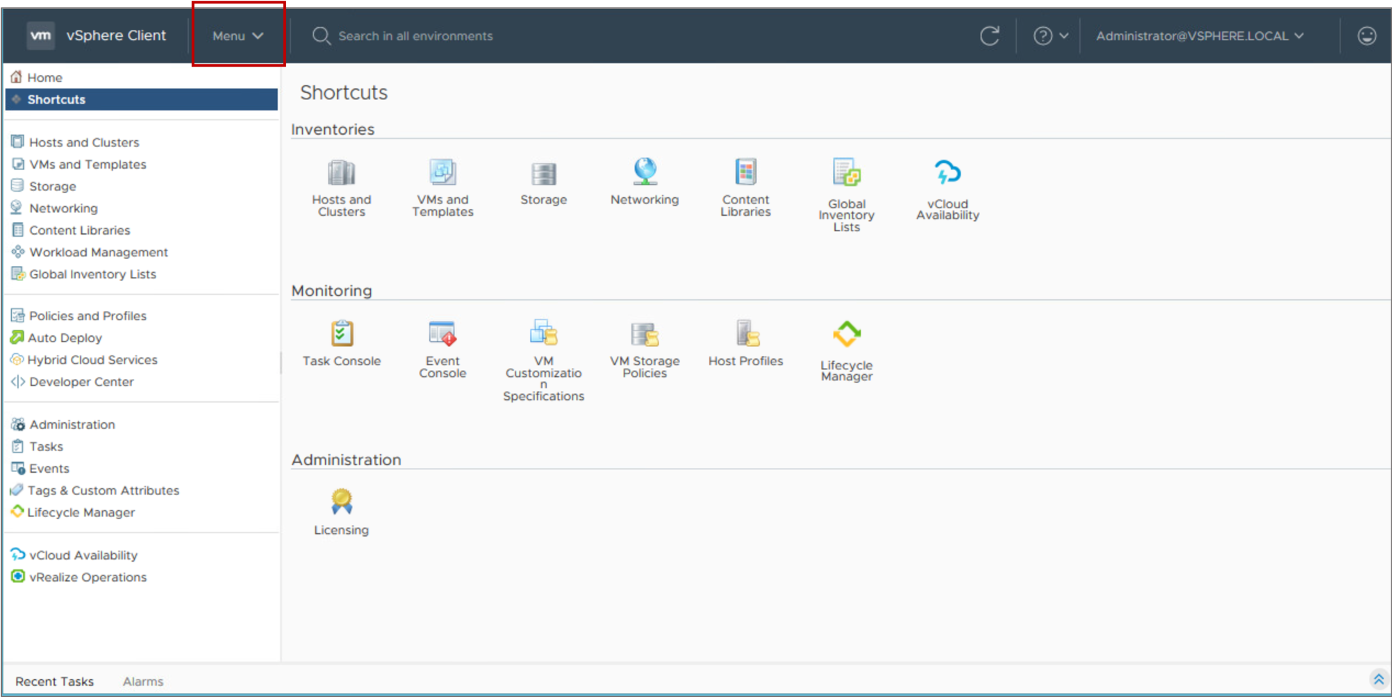
vSphere Client Shortcuts Page
From the vSphere Client Shortcuts page, you can manage your vCenter Server system inventory, monitor your infrastructure environment, and complete system administration tasks.
Notes:
Select Menu > Shortcuts. The Shortcuts page has a navigation pane on the left and Inventories, Monitoring, and Administration panes on the right.

Slide 41
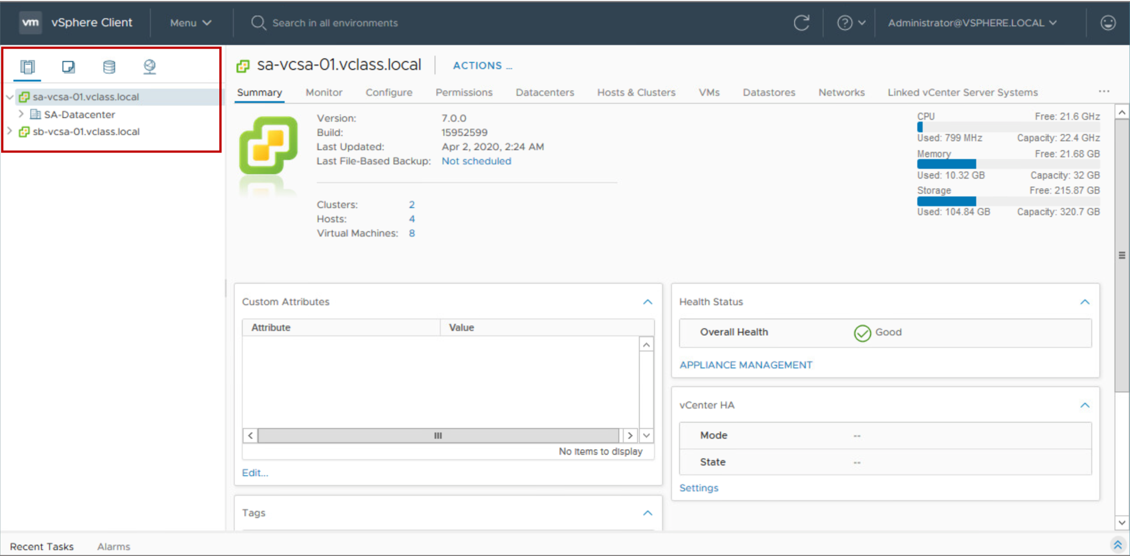
Using the Navigation Pane
You can use the navigation pane to browse and select objects in the vCenter Server inventory.

Slide 42
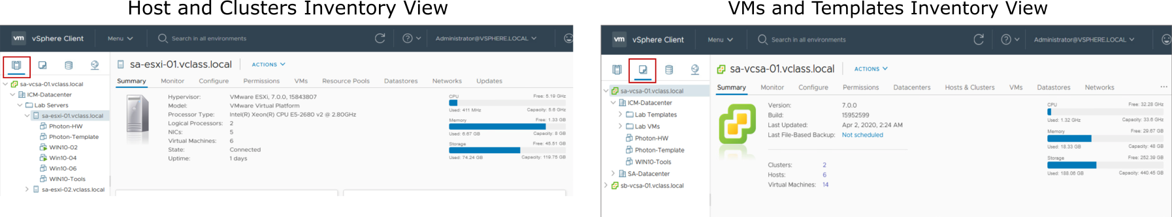
vCenter Server Views for Hosts, Clusters, VMs, and Templates
Host and cluster objects are shown in one view, and VM and template objects are displayed in another view.
Notes:
The Hosts and Clusters inventory view shows all host and cluster objects in a data center. You can further organize the hosts and clusters into folders.
The VMs and Templates inventory view shows all VM and template objects in a data center. You can also organize the VMs and templates into folders.

Slide 43
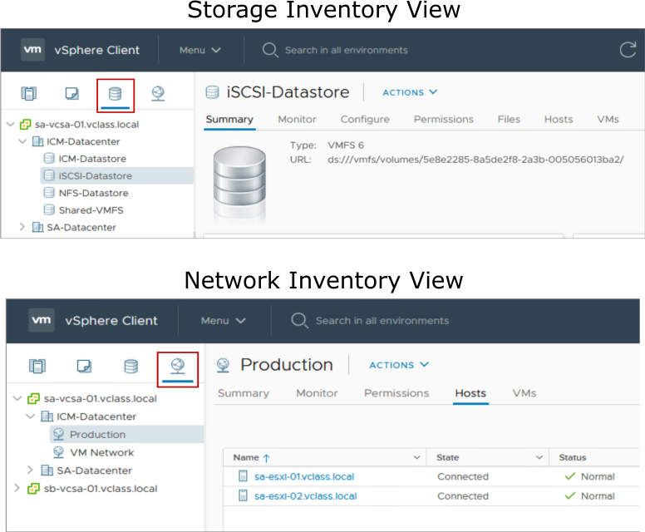
vCenter Server Views for Storage and Networks
The Storage inventory view shows all the details for datastores in the data center. The Networking inventory view shows all standard switches and distributed switches.
Notes:
As with the other inventory views, you can organize your datastore and network objects into folders.

Slide 44
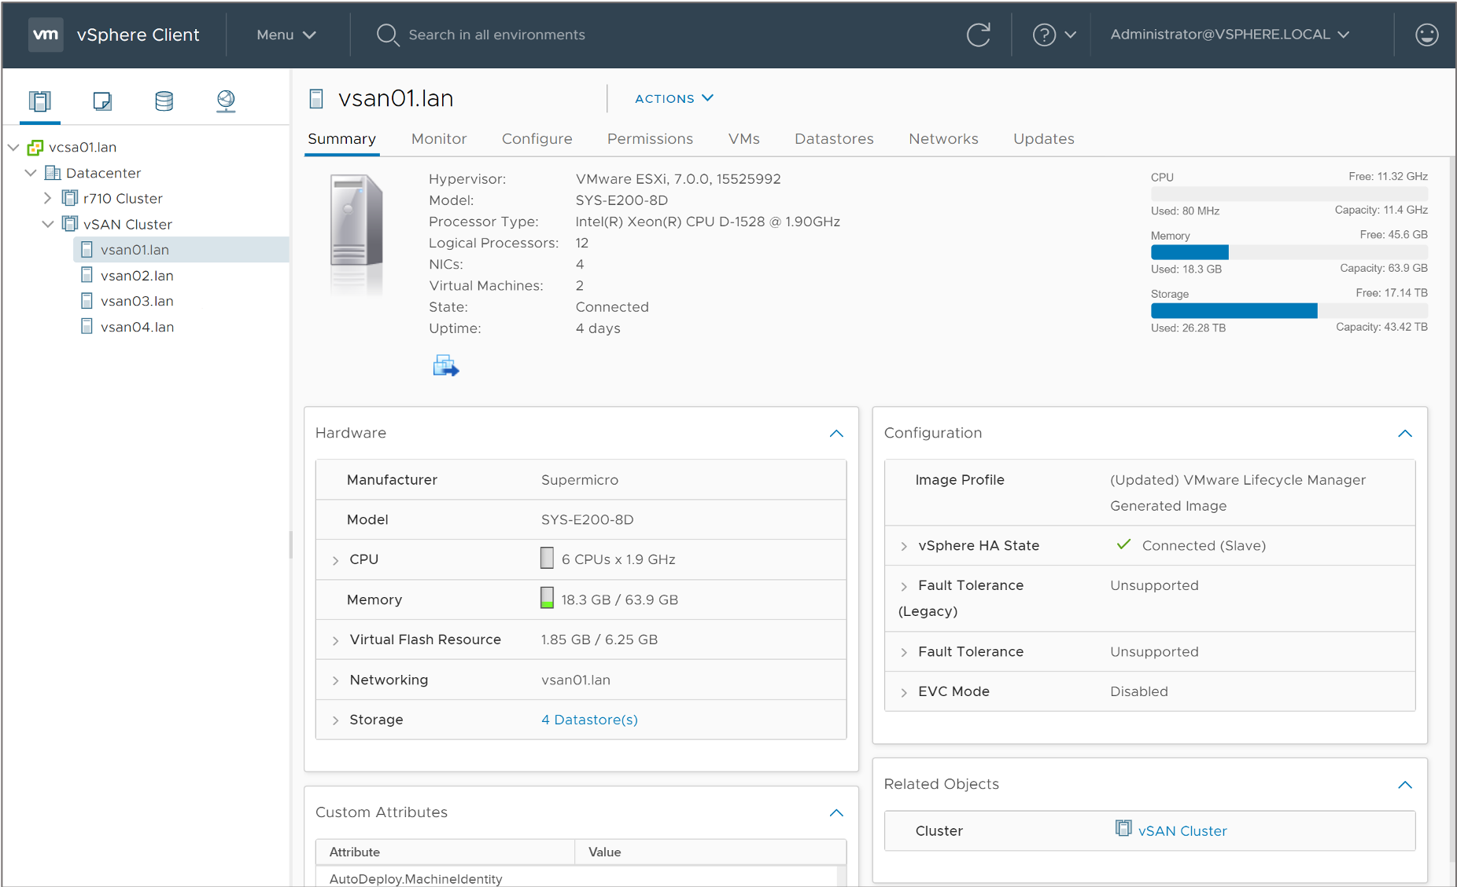
Viewing Object Information
Because you can view object information and access related objects, monitoring and managing object properties is easy.

Slide 45
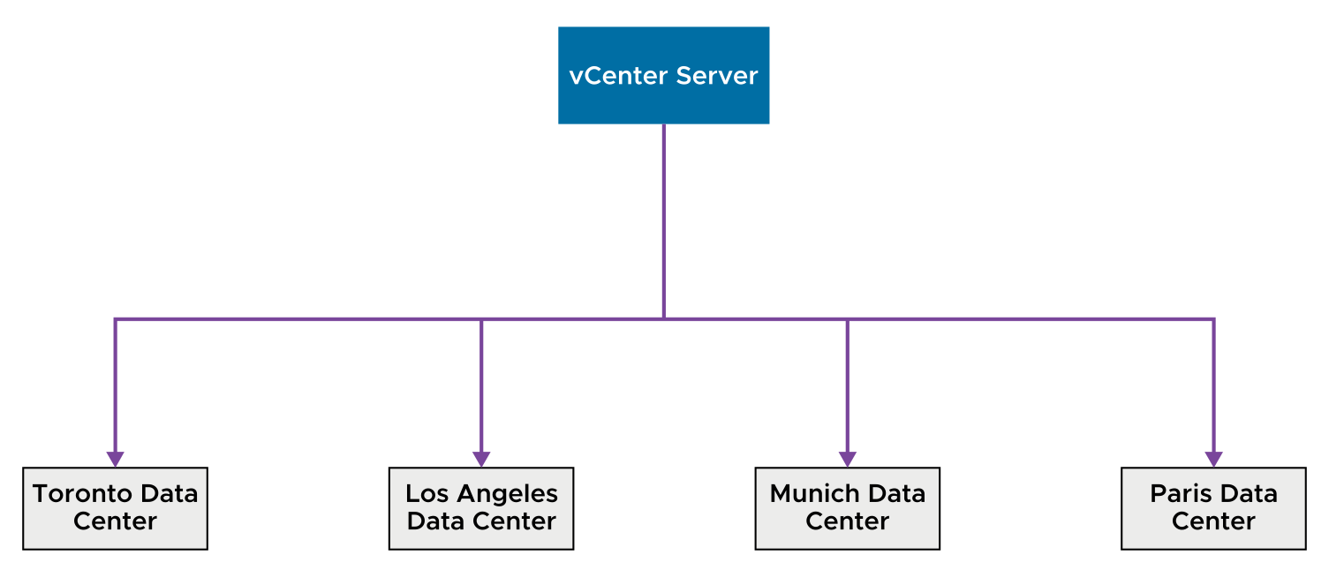
About Data Center Objects
A virtual data center is a logical organization of all the inventory objects required to complete a fully functional environment for operating VMs:
You can create multiple data centers to organize sets of environments.
Each data center has its own hosts, VMs, templates, datastores, and networks.
Notes:
You might create a data center object for each data center geographical location. Or, you might create a data center object for each organizational unit in your enterprise. You might create some data centers for high-performance environments and other data centers for less demanding VMs.

Slide 46
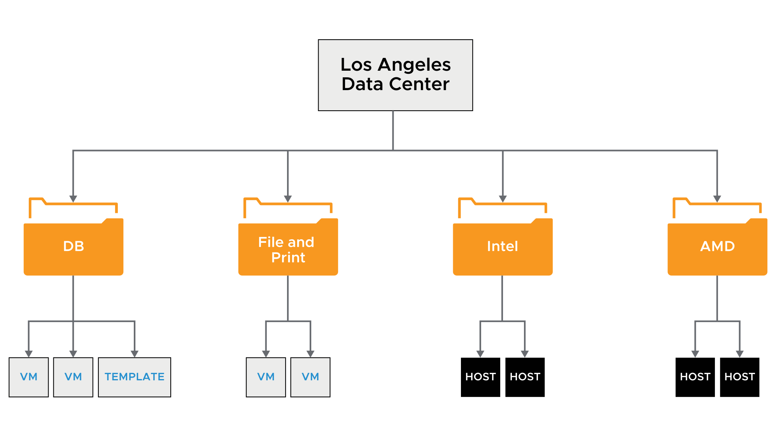
Organizing Inventory Objects into Folders
Objects in a data center can be placed into folders. You can create folders and subfolders to better organize systems.
Notes:
You plan the setup of your virtual environment depending on your requirements. A large vSphere implementation might contain several virtual data centers with a complex arrangement of hosts, clusters, resource pools, and networks. It might include multiple vCenter Server systems. Smaller implementations might require a single virtual data center with a less complex topology. Regardless of the scale of your virtual environment, consider how the VMs that it supports are used and administered.
Populating and organizing your inventory involves the following tasks:
Creating data centers
Creating clusters to consolidate the resources of multiple hosts and VMs
Adding hosts to the clusters or to the data centers
Organizing inventory objects in folders
Setting up networking by using vSphere standard switches or vSphere distributed switches
Configuring storage systems and creating datastore inventory objects to provide logical containers for storage devices in your inventory

Slide 47
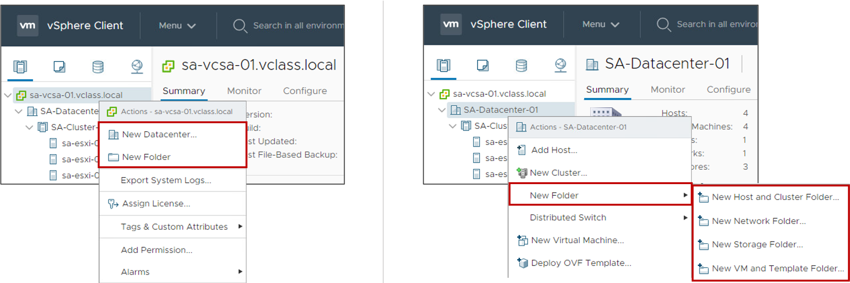
Adding a Data Center and Organizational Objects to vCenter Server
You can add a data center, a host, a cluster, and folders to vCenter Server.
You can use folders to group objects of the same type for easier management.

Slide 48
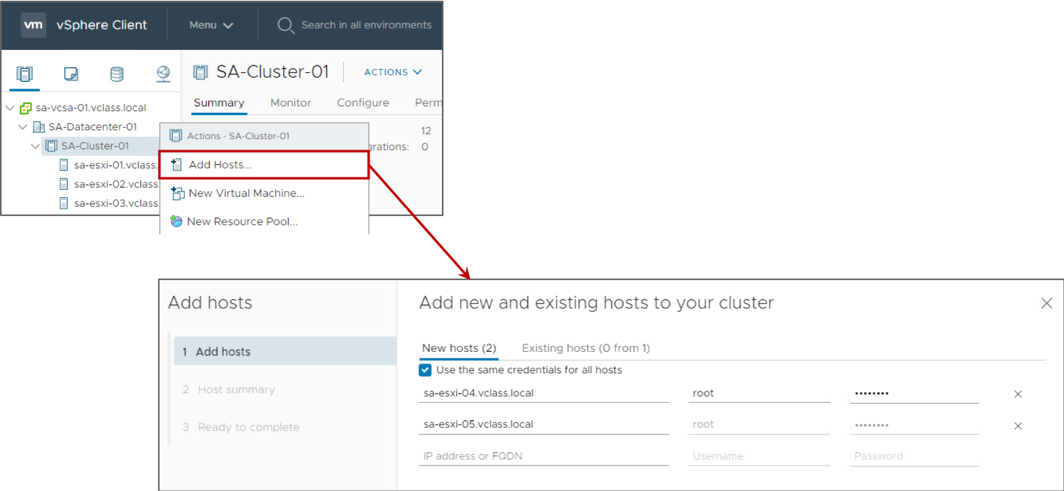
Adding ESXi Hosts to vCenter Server
You can add ESXi hosts to vCenter Server using the vSphere Client.

Slide 49
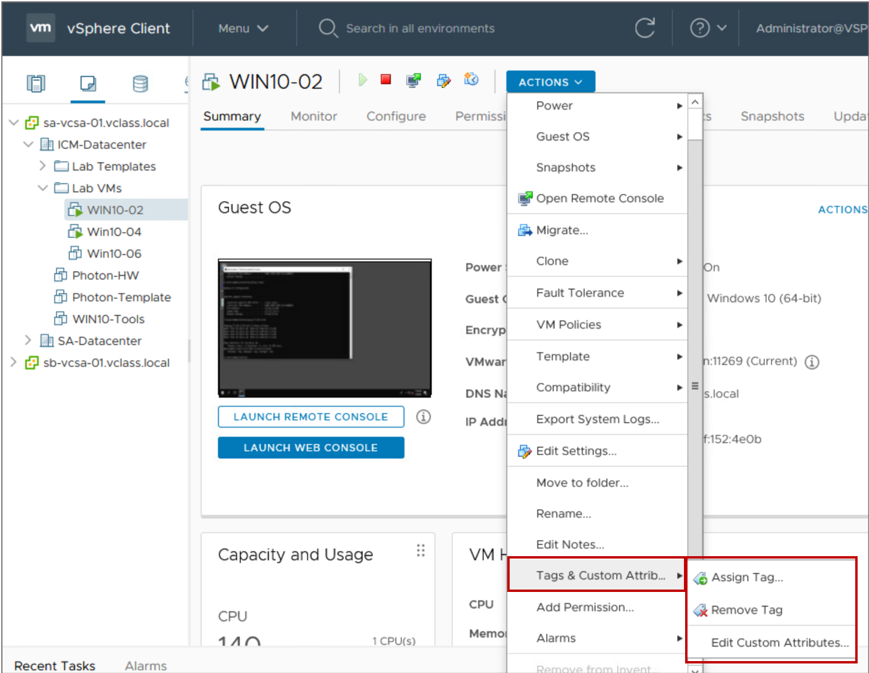
Creating Custom Tags for Inventory Objects
You can use tags to attach metadata to objects in the vCenter Server inventory. Tags help make these objects more sortable.
You can associate a set of objects of the same type by searching for objectives by a given tag.
You can use tags to group and manage VMs, clusters, and datastores, for example:
Tag VMs that run production workloads.
Tag VMs based on their guest operating system.

Slide 50
Labs
Lab: Creating and Managing the vCenter Server Inventory Lab: Configuring Active Directory: Joining a Domain

Slide 51
Lab 7: Creating and Managing the vCenter Server Inventory
Use the vSphere Client to create and configure objects in the vCenter Server inventory:
Create a Data Center Object
Add ESXi Hosts to the Inventory
View Information About the ESXi Hosts
Configure the ESXi Hosts as NTP Clients
Create a Folder for the ESXi Hosts
Create Folders for VMs and VM Templates

Slide 52
Lab 8: Configuring Active Directory: Joining a Domain
Join vCenter Server to the vclass.local domain:
Join vCenter Server to the vclass.local Domain

Slide 53
Review of Learner Objectives
After completing this lesson, you should be able to meet the following objectives:
Use the vSphere Client to manage the vCenter Server inventory
Create and organize vCenter Server inventory objects
Add data center and organizational objects to vCenter Server
Add hosts to vCenter Server
Recognize how to create custom inventory tags for inventory objects

Slide 54
Lesson 5: vCenter Server Roles and Permissions

Slide 55
Learner Objectives
After completing this lesson, you should be able to meet the following objectives:
Define the term permission in the context of vCenter Server
Describe the rules for applying permissions
Create a custom role
Create a permission

Slide 56
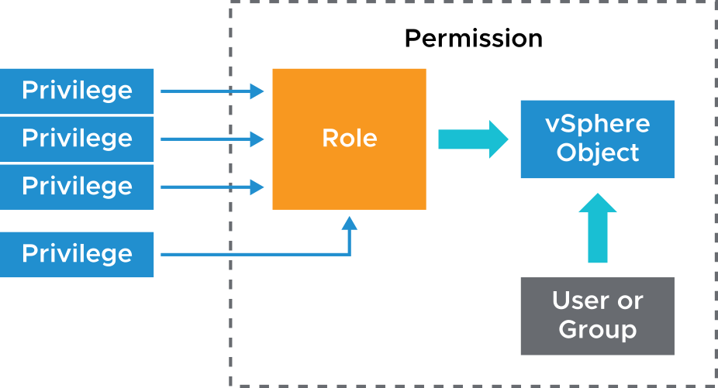
About vCenter Server Permissions
Using the access control system, the vCenter Server administrator can define user privileges to access objects in the inventory.
The following concepts are important:
Privilege: An action that can be performed
Object: The target of the action
User or group: Indication of who can perform the action
Role: A set of privileges
Permission: Gives one user or group a role (set of privileges) for the selected object
Notes:
The authorization to perform tasks in vCenter Server is governed by an access control system. Through this system, the vCenter Server administrator can specify in detail which users or groups can perform which tasks on which objects.
A permission is set on an object in the vCenter Server object hierarchy. Each permission associates the object with a group or user and the group or user access roles. For example, you can select a VM object, add one permission that gives the Read-only role to group 1, and add a second permission that gives the Administrator role to user 2.
By assigning a different role to a group of users on different objects, you control the tasks that those users can perform in your vSphere environment. For example, to allow a group to configure memory for the host, select that host and add a permission that grants a role to that group that includes the Host.Configuration.Memory Configuration privilege.

Slide 57
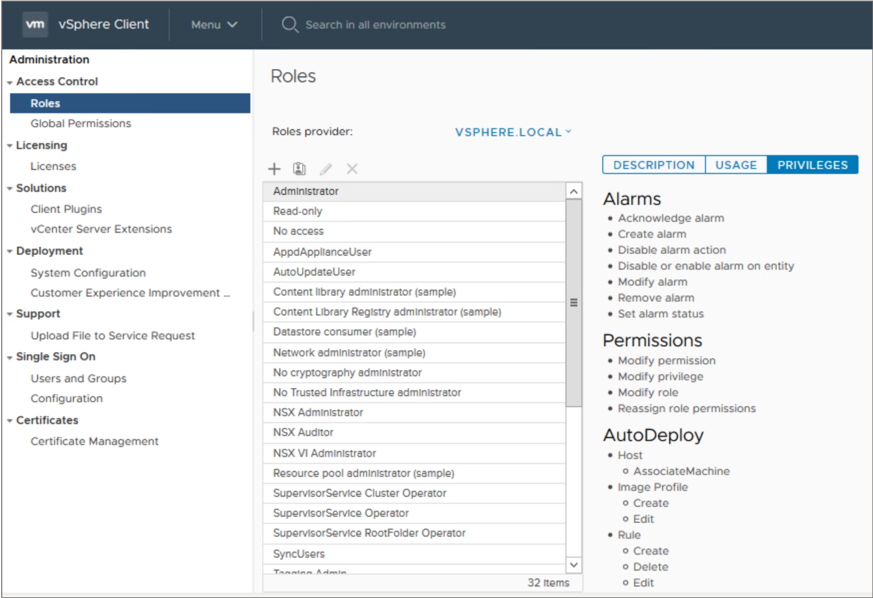
About Roles
Privileges are grouped into roles:
A privilege allows access to a specific task and is grouped with other privileges related to it.
Roles allow users to perform tasks.
vCenter Server provides a few system roles, which you cannot modify.
Notes:
A role is a set of one or more privileges. For example, the Virtual Machine Power User sample role consists of several privileges in categories such as Datastore and Global. A role is assigned to a user or group and determines the level of access of that user or group.
You cannot change the privileges associated with the system roles:
Administrator role: Users with this role for an object may view and perform all actions on the object.
Read-only role: Users with this role for an object may view the state of the object and details about the object.
No access role: Users with this role for an object may not view or change the object in any way.
No cryptography administrator role: Users with this role for an object have the same privileges as users with the Administrator role, except for privileges in the Cryptographic operations category.
All roles are independent of each other. Hierarchy or inheritance between roles does not apply.

Slide 58
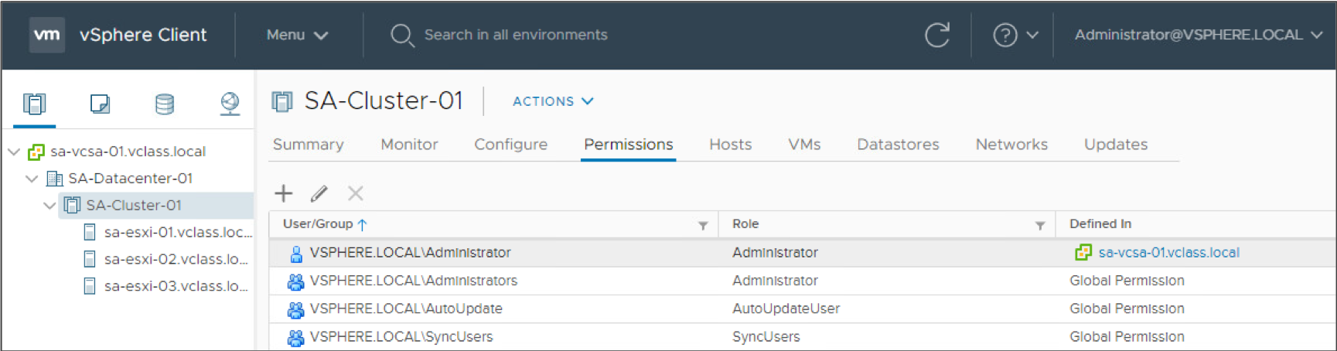
About Objects
Objects are entities on which actions are performed. Objects include data centers, folders, clusters, hosts, datastores, networks, and virtual machines.
All objects have a Permissions tab. The Permissions tab shows which user or group and role are associated with the selected object.

Slide 59
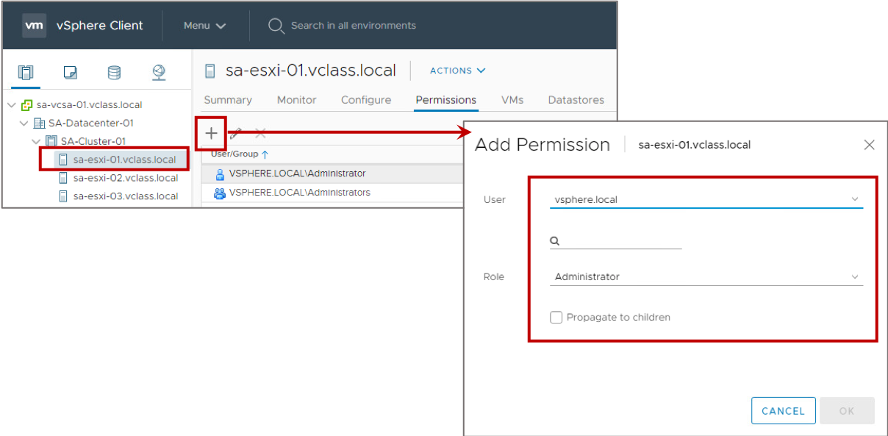
Adding Permissions to the vCenter Server Inventory
To add a permission:
Select an object.
Select a user or group from a domain.
Select a role.
Propagate the permission to the child objects.
Notes:
You can assign permissions to objects at different levels of the hierarchy. For example, you can assign permissions to a host object or to a folder object that includes all host objects. You can also assign permissions to a global root object to apply the permissions to all objects in all solutions.
For information about hierarchical inheritance of permissions and global permissions, see vSphere Security at https://docs.vmware.com/en/VMware-vSphere/7.0/com.vmware.vsphere.security.doc/GUID-52188148-C579-4F6A-8335-CFBCE0DD2167.html

Slide 60
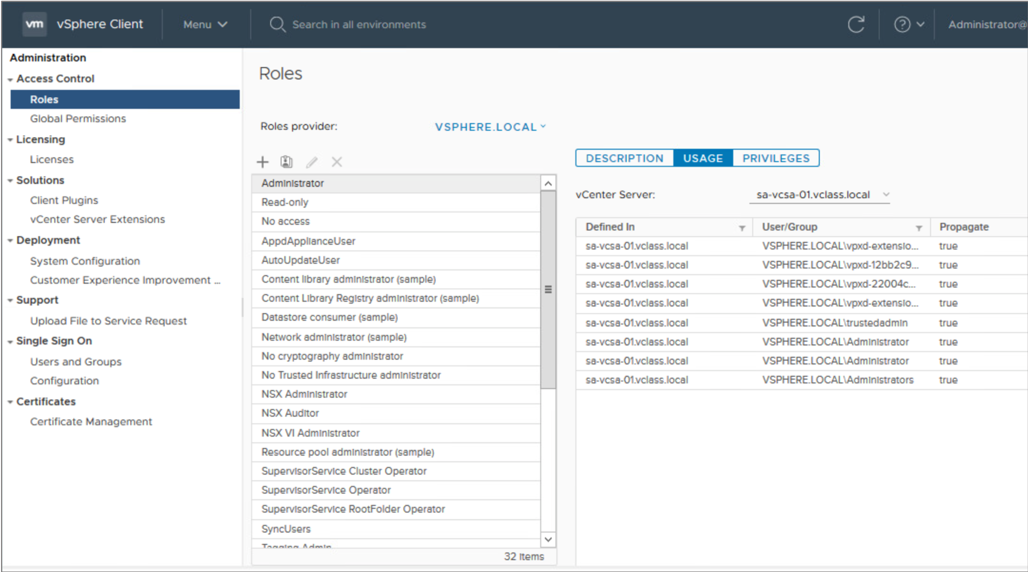
Viewing Roles and User Assignments
The Roles pane shows which users are assigned the selected role on a particular object.
Notes:
You can view all the objects to which a role is assigned and all the users or groups who are granted the role.
To view information about a role, click Usage in the Roles pane and select a role from the Roles list. The information provided to the right shows each object to which the role is assigned and the users and groups who were granted the role.

Slide 61
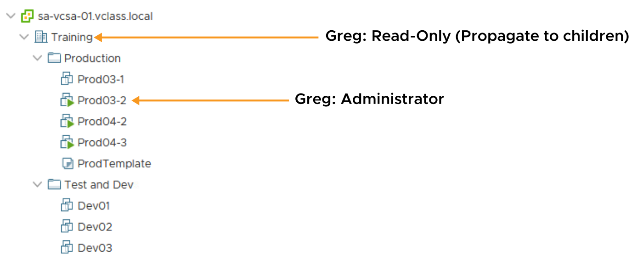
Applying Permissions: Scenario 1
A permission can propagate down the object hierarchy to all subobjects, or it can apply only to an immediate object.
Notes:
In addition to specifying whether permissions propagate downward, you can override permissions set at a higher level by explicitly setting different permissions for a lower-level object.
On the slide, user Greg is given Read-only access in the Training data center. This role is propagated to all child objects except one, the Prod03-2 VM. For this VM, Greg is an administrator.

Slide 62
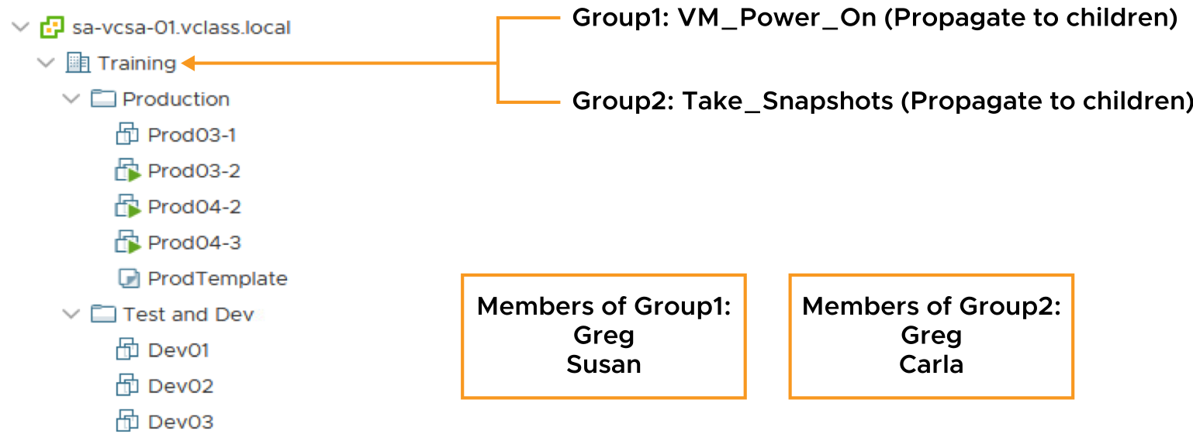
Applying Permissions: Scenario 2
When a user is a member of multiple groups with permissions on the same object, the user is assigned the union of privileges assigned to the groups for that object.
Notes:
On the slide, Group1 is assigned the VM_Power_On role, a custom role that contains only one privilege: the ability to power on a VM. Group2 is assigned the Take_Snapshots role, another custom role that contains the privileges to create and remove snapshots. Both roles propagate to the child objects.
Because Greg belongs to both Group1 and Group2, he gets both VM_Power_On and Take_Snapshots privileges for all objects in the Training data center.

Slide 63
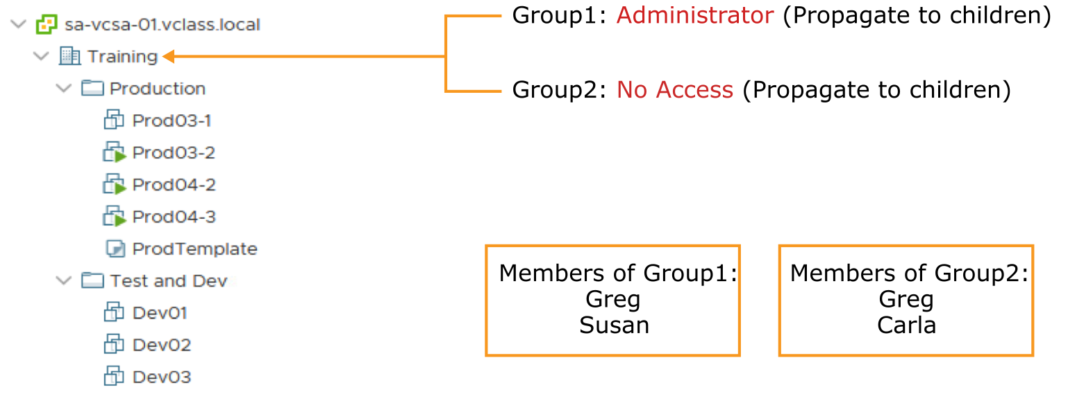
Activity: Applying Group Permissions (1)
If Group1 has the Administrator role and Group2 has the No Access role, what permissions does Greg have?

Slide 64
Activity: Applying Group Permissions (2)
Greg has Administrator privileges.
Greg is assigned the union of privileges assigned to Group1 and Group2.

Slide 65
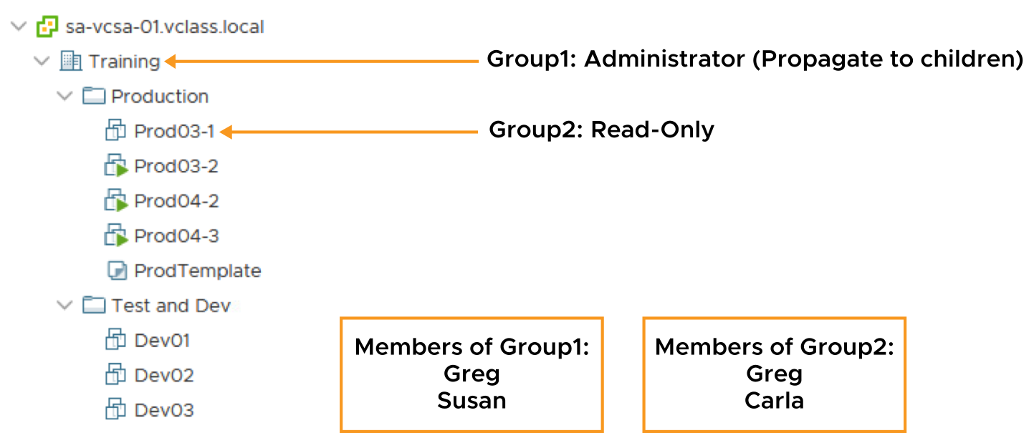
Applying Permissions: Scenario 3
A user can be a member of multiple groups with permissions on different objects. In this case, the same permissions apply for each object on which the group has permissions, as though the permissions were granted directly to the user.
Notes:
You can override permissions set for a higher-level object by explicitly setting different permissions for a lower-level object.
On the slide, Group1 is assigned the Administrator role at the Training data center and Group2 is assigned the Read-only role on the VM object, Prod03-1. The permission granted to Group1 is propagated to child objects.
Because Greg is a member of both Group1 and Group2, he gets administrator privileges on the entire Training data center (the higher-level object), except for the VM called Prod03-1 (the lower-level object). For this VM, he gets read-only access.

Slide 66
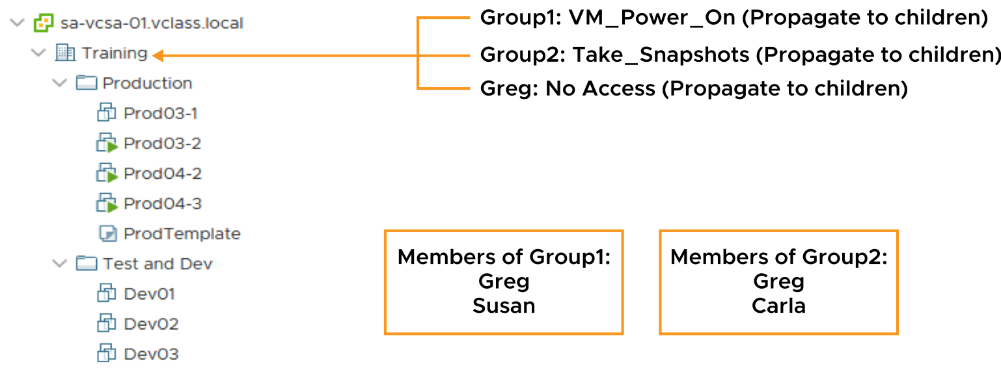
Applying Permissions: Scenario 4
A user (or group) is given only one role for any given object.
Permissions defined explicitly for the user on an object take precedence over all group permissions on that same object.
Notes:
On the slide, three permissions are assigned to the Training data center:
Group1 is assigned the VM_Power_On role.
Group2 is assigned the Take_Snapshots role.
Greg is assigned the No Access role.
Greg is a member of both Group1 and Group2. Assume that propagation to child objects is enabled on all roles. Although Greg is a member of both Group1 and Group2, he gets the No Access privilege to the Training data center and all objects under it. Greg gets the No Access privilege because explicit user permissions on an object take precedence over all group permissions on that same object.

Slide 67
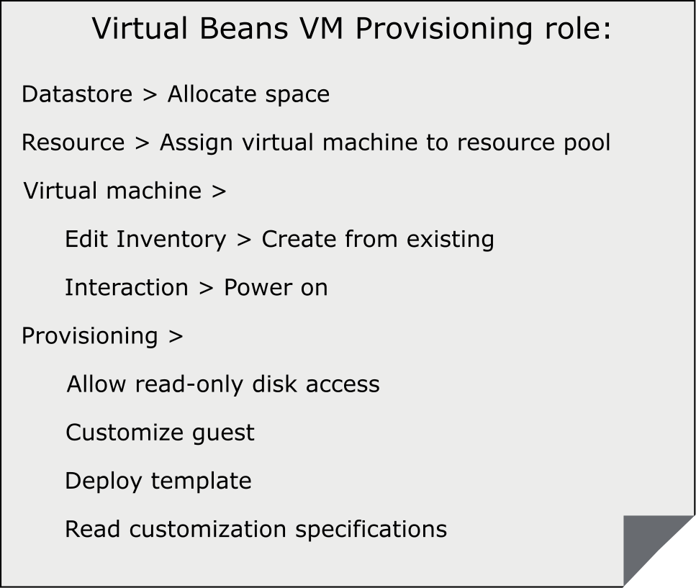
Creating a Role
Create roles for only necessary tasks.
For example, you can create a Virtual Beans VM Provisioning role that allows a user to deploy VMs from a template.
Use folders to contain the scope of permissions. For instance, assign the Virtual Beans VM Provisioning role to user nancy@vmbeans.com and apply it to the Production VMs folder.
Notes:
The Virtual Beans VM Provisioning role is one of many examples of roles that can be created. Define a role using the smallest number of privileges possible to maximize security and control over your environment. Give the roles names that explicitly indicate what each role allows, to make its purpose clear.

Slide 68
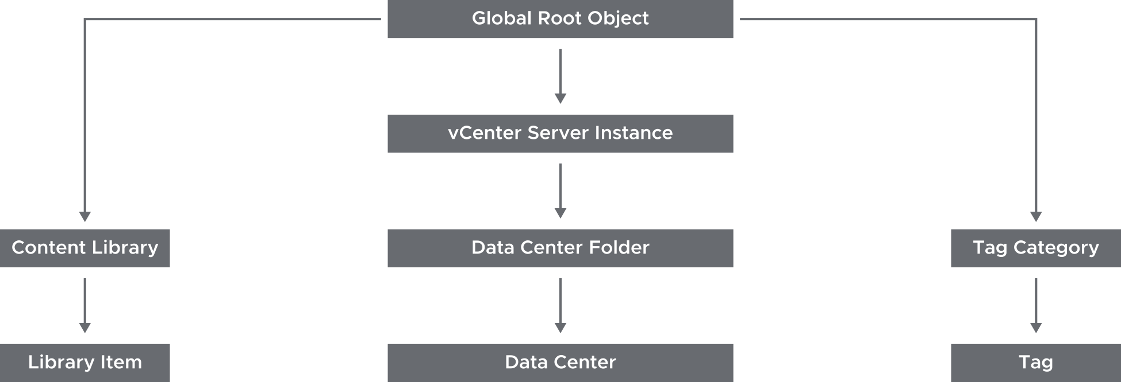
About Global Permissions
Global permissions support assigning privileges across solutions from a global root object:
Span solutions such as vCenter Server and vRealize Orchestrator
Give a user or group privileges for all objects in all object hierarchies
Notes:
Often, you apply a permission to a vCenter Server inventory object such as an ESXi host or a VM. When you apply a permission, you specify that a user or group has a set of privileges, called a role, on the object. Global permissions give a user or group privileges to view or manage all objects in each of the inventory hierarchies in your deployment. The example on the slide shows that the global root object has permissions over all vCenter Server objects, including content libraries, vCenter Server instances, and tags. Global permissions allow access across vCenter Server instances. vCenter Server permissions, however, are effective only on objects in a particular vCenter Server instance.

Slide 69
Labs
Lab: Configuring Active Directory: Adding an Identity Source Lab: Users, Groups, and Permissions

Slide 70
Lab 9: Configuring Active Directory: Adding an Identity Source
Add vclass.local as an identity source:
Add vclass.local as an Identity Source

Slide 71
Lab 10: Users, Groups, and Permissions
Assign roles and permissions so that an Active Directory user can perform functions in vCenter Server:
View Active Directory Users
Assign Object Permission to an Active Directory User
Assign Root-Level Global Permission to an Active Directory User
Log In as an Active Directory User
Use an Active Directory User to Create a Virtual Machine

Slide 72
Review of Learner Objectives
After completing this lesson, you should be able to meet the following objectives:
Define the term permission in the context of vCenter Server
Describe the rules for applying permissions
Create a custom role
Create a permission

Slide 73
Lesson 6: Backing Up and Restoring vCenter Server Appliance

Slide 74
Learner Objectives
After completing this lesson, you should be able to meet the following objectives:
Create a vCenter Server Appliance backup schedule
Restore vCenter Server Appliance from backup

Slide 75
Virtual Beans: vCenter Server Operations
As a Virtual Beans administrator, you are responsible for the maintenance and daily operation of vCenter Server.
To align with Virtual Beans policies, you perform the following tasks:
Back up vCenter Server data monthly.
Make vCenter Server highly available:
99.99 percent available (downtime per year of 52.56 minutes)
Monitor vCenter Server performance to avoid potential problems in the infrastructure.

Slide 76
About vCenter Server Backup and Restore
vCenter Server backup and restore operations protect data. These operations work in the following ways:
Use the vCenter Server Appliance Management Interface
Remove dependency on third-party backup solutions
Support FTPS, HTTP, HTTPS, SFTP, FTP, NFS, and SMB
Include the option to encrypt backups
Restore directly from the vCenter Server Appliance GUI installer
Restore a vCenter Server instance to a brand-new appliance
Notes:
The vCenter Server Appliance Management Interface supports backing up key parts of the appliance. You can protect vCenter Server data and minimize the time required to restore data center operations.
The backup process collects key files into a tar bundle and compresses the bundle to reduce the network load. To minimize the storage impact, the transmission is streamed without caching in the appliance. To reduce the total time required to complete the backup operation, the backup process handles the different components in parallel.
You can encrypt the compressed file before transmission to the backup storage location. When you choose encryption, you must supply a password that can be used to decrypt the file during restoration.
The backup operation always includes the vCenter Server database and system configuration files, so that a restore operation has all the data to recreate an operational appliance. Optionally, you can specify that a backup operation should include Statistics, Events, and Tasks from the current state of the data center. Current alarms are always included in a backup.

Slide 77
Methods for vCenter Server Appliance Backup and Restore
You can use different methods to back up and restore vCenter Server Appliance:
File-based backup and restore:
Use the vCenter Server Appliance Management Interface to create a file-based backup.
Restore the backup through the GUI installer of the appliance.
Schedule the file-based backup and restore.
Image-based backup and restore:
Use vSphere Storage APIs - Data Protection with a third-party backup product to perform centralized, efficient, off-host, LAN-free backups.

Slide 78
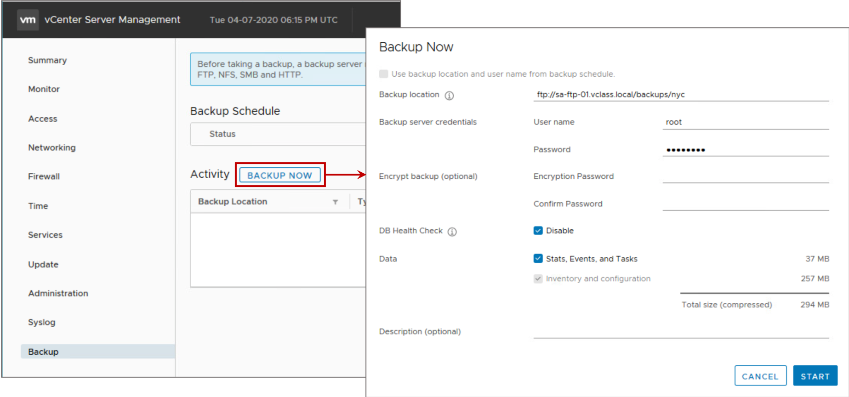
File-Based Backup of vCenter Server Appliance
You can perform a file-based backup manually.
Notes:
You use the vCenter Server Appliance Management Interface to perform a file-based backup of the vCenter Server core configuration, inventory, and historical data of your choice. The backed-up data is streamed over the selected protocol to a remote system. The backup is not stored on vCenter Server Appliance.
When specifying the backup location, use the following syntax: protocol:<server-address<:port-number>/folder/subfolder.

Slide 79
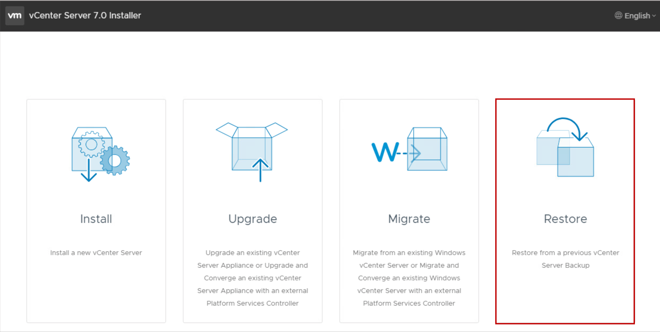
File-Based Restore of vCenter Server Appliance
Use the vCenter Server Appliance GUI installer to restore a vCenter Server Appliance to an ESXi host or a vCenter Server instance.
The restore procedure occurs in stages:
A new appliance is deployed.
The newly deployed vCenter Server Appliance is populated with the data stored in the file-based backup.
When you use the file-based restore method, reconciliation is automatically performed.
Notes:
You can perform a file-based restore only for a vCenter Server Appliance instance that you previously backed up by using the vCenter Server Appliance Management Interface. You can perform the restore operation by using the GUI installer of vCenter Server Appliance. The process consists of deploying a new vCenter Server Appliance instance and copying the data from the file-based backup to the new appliance.
You can also perform a restore operation by deploying a new vCenter Server Appliance instance and using the vCenter Server Appliance Management Interface to copy the data from the file-based backup to the new appliance.

Slide 80
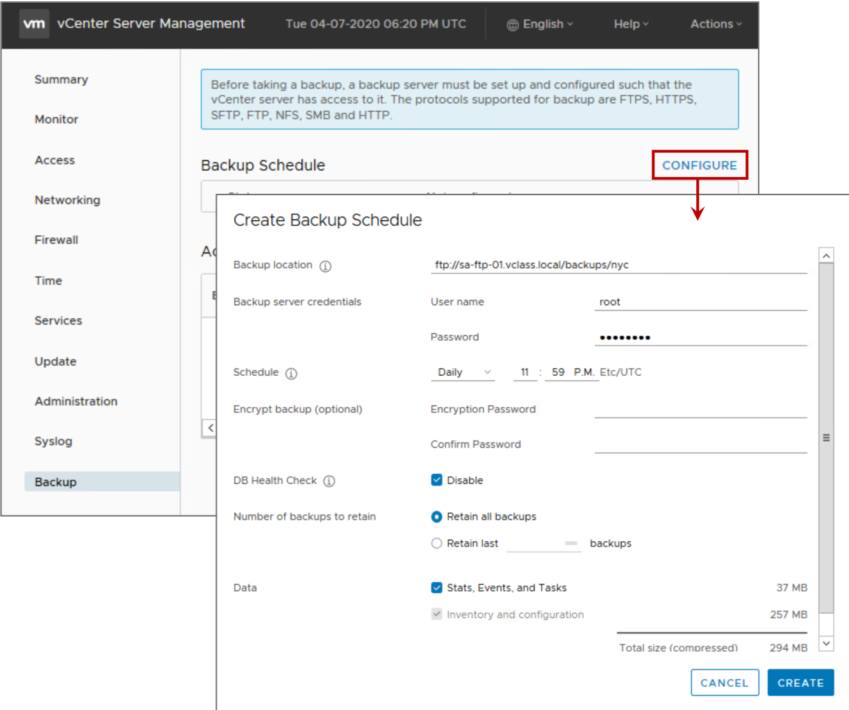
Scheduling Backups
You can schedule automatic file-based backups.
The backup scheduler supports:
A retention policy to keep all backups or a defined number of backups
Daily, weekly, or custom schedule
Failed backups trigger an alarm in the vSphere Client.
Notes:
You can set up a file-based backup schedule to perform periodic backups:
The schedule can be set up with information about the backup location, recurrence, and retention for the backups.
You can set up only one schedule at a time.

Slide 81
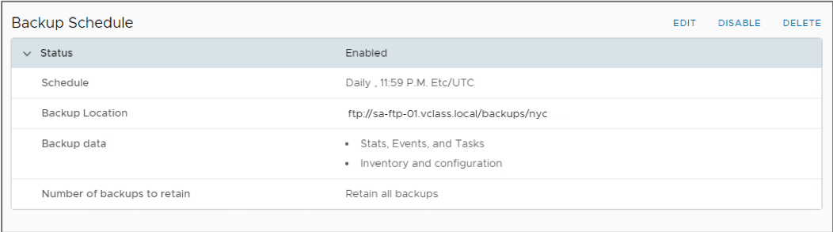
Viewing the Backup Schedule
You can view the existing defined backup schedule from the vCenter Server Appliance Management Interface.
The backup schedule can be edited, disabled, or deleted.

Slide 82
Demonstration: Backing Up and Restoring a vCenter Server Appliance Instance
Your instructor will run a demonstration.

Slide 83
Review of Learner Objectives
After completing this lesson, you should be able to meet the following objectives:
Create a vCenter Server Appliance backup schedule
Restore vCenter Server Appliance from backup

Slide 84
Lesson 7: Monitoring vCenter Server Appliance

Slide 85
Learner Objectives
After completing this lesson, you should be able to meet the following objectives:
View vCenter Server logs and events
Manage vCenter Server services
Monitor vCenter Server Appliance for service and disk space usage
Use vSphere alarms for resource exhaustion and service failures

Slide 86
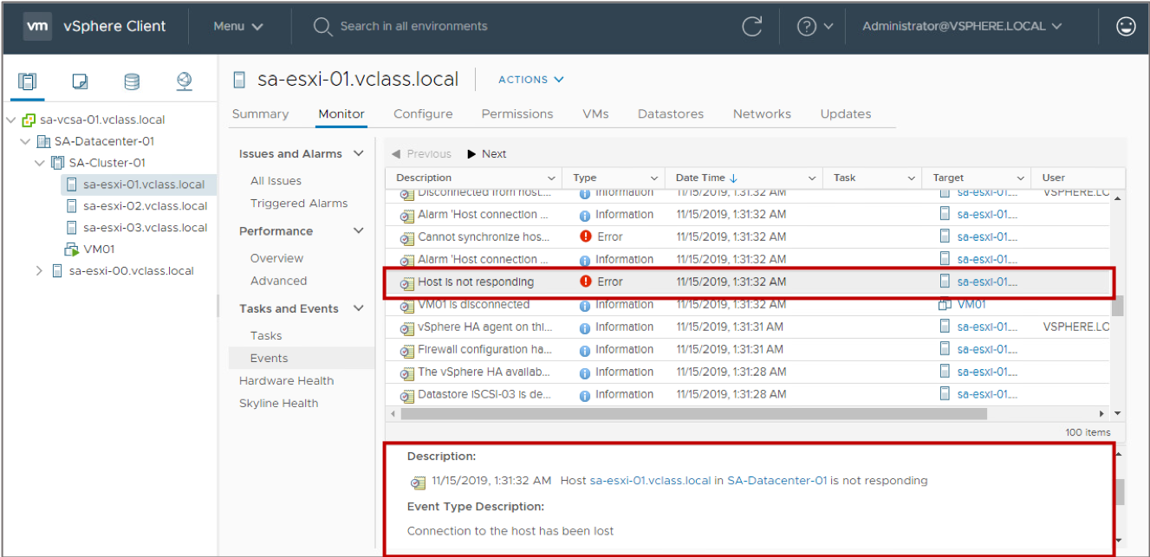
vCenter Server Events
The vCenter Server events and audit trails allow selectable retention periods in increments of 30 days:
User-action information includes the user’s account and specific event details.
All actions are reported, including file ID, file path, source of operation, operation name, and date and time of operation.
Events and alarms are displayed to alert the user to changes in the vCenter Server service health or when a service fails.

Slide 87
About Log Levels
You can set log levels to control the quantity and type of information logged.
Examples of when to set log levels:
When troubleshooting complex issues, set the log level to verbose or trivia. Troubleshoot and set it back to info.
For controlling the amount of information being stored in the log files.
Option | Description
None | Turns off logging
Error (errors only) | Displays only error log entries
Warning (errors and warnings) | Displays warning and error log entries
Info (normal logging) | Displays information, error, and warning log entries
Verbose | Displays information, error, warning, and verbose log entries
Trivia (extended verbose) | Displays information, error, warning, verbose, and trivia log entries
Notes:
Changes to the logging settings take effect immediately. You do not have to restart the vCenter Server system.

Slide 88
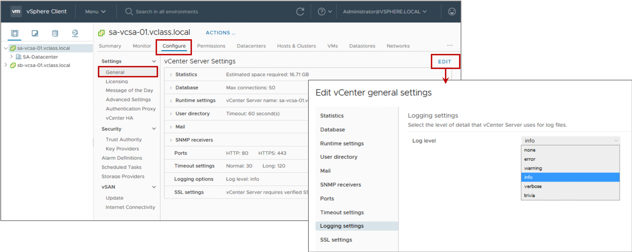
Setting Log Levels
You can configure the amount of detail that vCenter Server collects in log files:
You can edit the log levels in the vSphere Client.
More verbose logging requires more space on your vCenter Server system.
Notes:
To configure logging levels, follow these steps:
In the vSphere Client, select the vCenter Server instance in the navigation pane.
Click the Configure tab.
Under Settings, select General.
Click EDIT.
Under Edit vCenter general settings, select Logging settings in the left pane.
Select an option from the Log level drop-down menu.

Slide 89
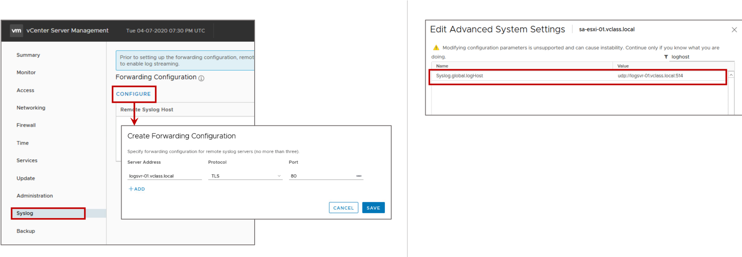
Forwarding vCenter Server Appliance Log Files to a Remote Host
vCenter Server and ESXi can stream their log information to a remote Syslog server:
You can enable this feature in the vCenter Server Appliance Management Interface.
With this feature, you can further analyze vCenter Server Appliance log files with log analysis products, such as vRealize Log Insight.

Slide 90
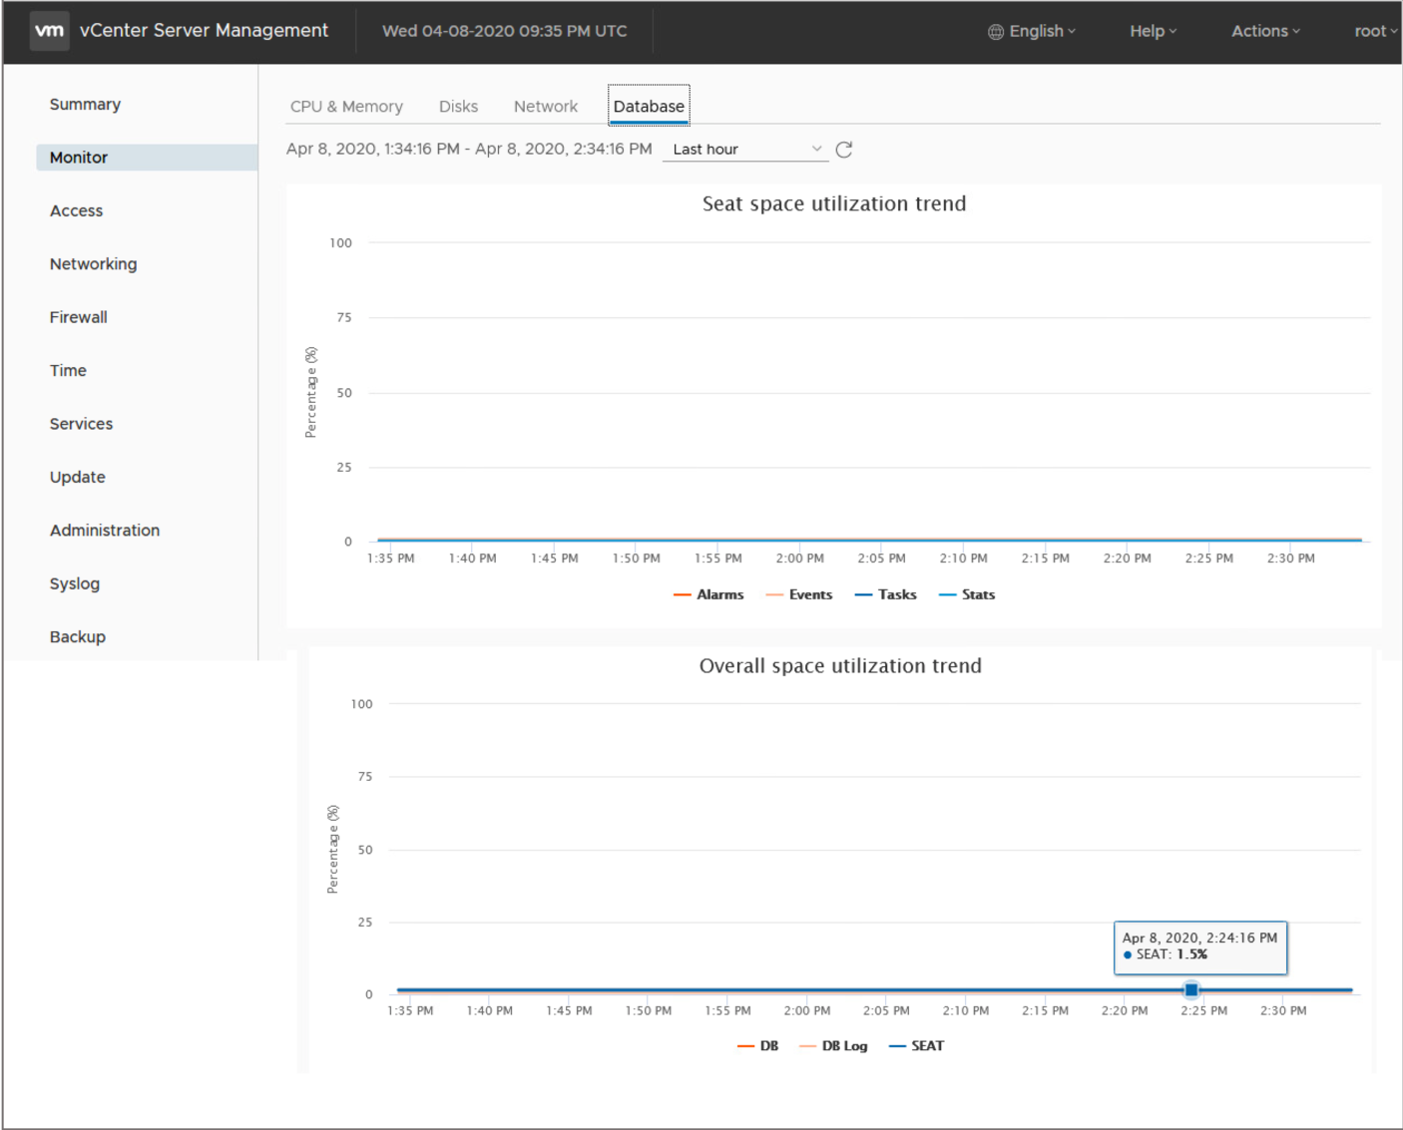
vCenter Server Database Health
vCenter Server checks the status of the database every 15 minutes:
By default, database health warnings trigger an alarm when the space used reaches 80 percent.
The alarm changes from warning to error when the space used reaches 95 percent.
vCenter Server services shut down so that you can configure more disk space or remove unwanted content.
You can also monitor database space utilization using the vCenter Server Appliance Management Interface.

Slide 91
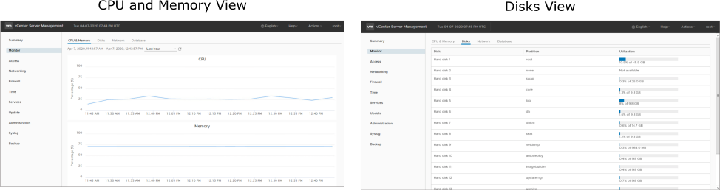
Monitoring vCenter Server Appliance
The vCenter Server Appliance Management Interface has a built-in monitoring interface.
Notes:
The CPU and Memory views provide a historical view of CPU and memory use.
Using the Disks view, you can monitor the available disk space.

Slide 92
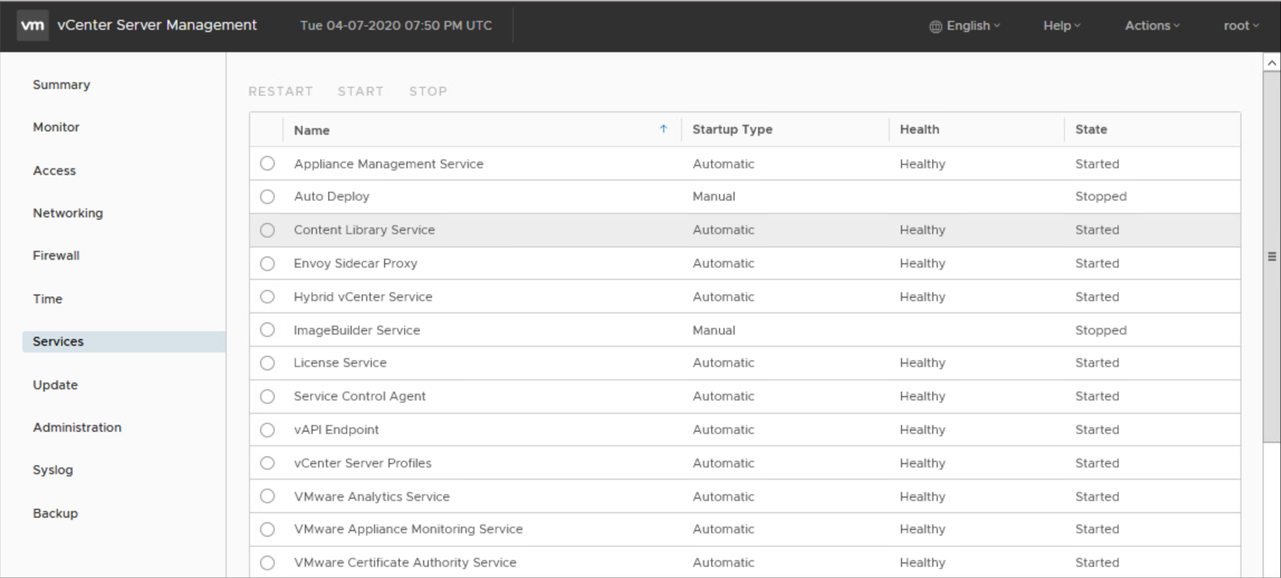
Monitoring vCenter Server Appliance Services
You can use the vCenter Server Appliance Management Interface to monitor the health and state of the vCenter Server Appliance services. You can restart, start, or stop services from this interface.

Slide 93

Monthly Patch Updates for vCenter Server Appliance
VMware provides monthly security patches for vCenter Server Appliance:
Critical vulnerability patches are delivered on a monthly release cycle.
Important and low vulnerabilities are delivered with the next available vCenter Server patch or update.
You can configure the vCenter Server Appliance to perform automatic checks for available patches in the configured repository URL at a regular interval.
Notes:
If a vCenter Server patch or update occurs in the same time period as the monthly security patch, the monthly security patch is rolled into the vCenter Server patch or update.

Slide 94
Review of Learner Objectives
After completing this lesson, you should be able to meet the following objectives:
View vCenter Server logs and events
Manage vCenter Server services
Monitor vCenter Server Appliance for service and disk space usage
Use vSphere alarms for resource exhaustion and service failures

Slide 95
Lesson 8: vCenter Server High Availability

Slide 96
Learner Objectives
After completing this lesson, you should be able to meet the following objectives:
Recognize the importance of vCenter Server High Availability
Explain how vCenter Server High Availability works
Identify vCenter Server High Availability requirements

Slide 97

Importance of Keeping vCenter Server Highly Available
High availability is an important characteristic for many VMware and third-party solutions that depend on vCenter Server as the primary management platform:
vCenter Server is the foundation for the virtual desktop infrastructure.
Backup and disaster recovery solutions rely on vCenter Server.
Notes:
vSphere is a virtualization platform that forms the foundation for building and managing an organization's virtual, public, and private cloud infrastructures. vCenter Server Appliance sits at the heart of vSphere and provides services to manage various components of a virtual infrastructure, such as ESXi hosts, virtual machines, and storage and networking resources. As large virtual infrastructures are built using vSphere, vCenter Server becomes an important element in ensuring the business continuity of an organization. vCenter Server must protect itself from a set of hardware and software failures in an environment and must recover transparently from such failures.

Slide 98

About vCenter Server High Availability
vCenter Server High Availability protects vCenter Server Appliance against both hardware and software failures.
vCenter Server High Availability forms a cluster of nodes:
Active node: Runs the active vCenter Server Appliance instance
Passive node: Automatically takes over the role of the Active node if a failure occurs
Witness node: Provides a quorum to protect against a split-brain situation
vCenter Server High Availability is built in to vCenter Server Appliance and is included with the standard license.
Notes:
With vCenter Server High Availability, you can recover quickly from a vCenter Server failure. Using automated failover, vCenter Server failover occurs with minimal downtime.

Slide 99

Scenario: Active Node Failure
If the active node fails, the passive node takes over the role of the active node. The cluster is considered to be running in a degraded state.
Notes:
The animation demonstrates what happens if an active node fails. To play the animation, go to https://vmware.bravais.com/s/PlUBZn2zCO7HE5qN2fm4.
The active node runs the active instance of vCenter Server Appliance. The node uses an IP address on the Management network for the vSphere Client to connect to.
If the active node fails (because of a hardware, software, or network failure), the passive node takes over the role of the active node. The IP address to which the vSphere Client was connected is switched from the failed node to the new active node. The new active node starts serving client requests. Meanwhile, the user must log back in to the vSphere Client for continued access to vCenter Server.
Because only two nodes are up and running, the vCenter Server High Availability cluster is considered to be running in a degraded state and subsequent failover cannot occur. A subsequent failure in a degraded cluster means vCenter Server services are no longer available. A passive node is required to return the cluster to a healthy state.

Slide 100

Scenario: Passive Node Failure
If the passive node fails, the active node continues to operate normally. However, the cluster is considered to be running in a degraded state.
Notes:
If the passive node fails, the active node continues to operate as normal. Because no disruption in service occurs, users can continue to access the active node using the vSphere Client.
Because the passive node is down, the active node is no longer protected. The cluster is considered to be running in a degraded state because only two nodes are up and running. A subsequent failure in a degraded cluster means vCenter Server services are no longer available. A passive node is required to return the cluster to a healthy state.

Slide 101

Scenario: Witness Node Failure
If the witness node fails, the active node continues to operate normally. However, the cluster is considered to be running in a degraded state.
Notes:
The witness node is used to maintain quorum.
If the witness node fails, the active node continues to operate without disruption in service. Because only two nodes are up and running, the cluster is considered to be running in a degraded state and failover cannot occur. A subsequent failure in a degraded cluster means vCenter Server services are no longer available. The witness node is required to return the cluster to a healthy state.

Slide 102
Benefits of vCenter Server High Availability
vCenter Server High Availability provides many benefits:
vCenter Server Appliance is made more resilient.
Protection against hardware, host, and application failures is provided.
Recovery occurs in minutes. End-to-end downtime is minimized.
Active-passive architecture provides transparent failover:
Recovery point objective: No data loss.
Recovery time objective: Within minutes.
One-click automated high availability is set up.
Nodes can be geographically distant (less than 10 milliseconds latency).
No shared storage is required.
No third-party technologies are required.

Slide 103
vCenter Server High Availability Requirements
Component | Requirements
ESXi | Version 6.0 or later. Minimum of three ESXi hosts is recommended.
vCenter Server Appliance | Version 6.5 or later. Deployment size small or larger is required to meet the RTO. Enough disk space to collect and store support bundles for all three nodes on the active node.
Network connectivity | Network latency between the three nodes must be less than 10 milliseconds. The vCenter HA network must be on a different subnet than the management network.
Licensing | A single vCenter Server Standard license.
Notes:
For more information about the vCenter Server High Availability requirements, see vSphere Availability at https://docs.vmware.com/en/VMware-vSphere/7.0/com.vmware.vsphere.avail.doc/GUID-63F459B7-8884-4818-8872-C9753B2E0215.html.

Slide 104
Demonstration: Configuring vCenter Server High Availability
Your instructor will run a demonstration.

Slide 105
Review of Learner Objectives
After completing this lesson, you should be able to meet the following objectives:
Recognize the importance of vCenter Server High Availability
Explain how vCenter Server High Availability works
Identify vCenter Server High Availability requirements

Slide 106
Virtual Beans: vCenter Server Maintenance and Operations
As a Virtual Beans administrator, you plan to maintain vCenter Server and keep it up and running.
Virtual Beans Requirement | Plan
Back up vCenter Server data monthly. | Use the VAMI to schedule monthly backups of vCenter Server. Because the NFS protocol is supported, you can use one of the NFS filesystems in your data center to store the backups.
Make vCenter Server highly available. | Configure vCenter Server High Availability to protect against vCenter Server failures. Because recovery time is minimal, you are confident that 99.99 percent availability (downtime per year of 52.56 minutes) can be achieved.
Monitor vCenter Server regularly. | Use the vSphere Client and VAMI daily to monitor vCenter Server health and performance.

Slide 107
Key Points
vCenter Server Appliance uses the Photon operating system and the PostgreSQL database.
You use the vSphere Client to connect to vCenter Server instances and manage vCenter Server inventory objects.
A permission, defined in vCenter Server, gives one user or group a role (set of privileges) for a selected object.
You can use the vCenter Server Appliance Management Interface to monitor appliance resource use and perform a file-based backup of the appliance.
vCenter Server High Availability is built in to vCenter Server Appliance and protects the appliance from both hardware and software failures.
Questions?

